Slide 1
Introduction to PostGIS
http://postgis.net/workshops/postgis-intro

Slide 2
Section 1 - Welcome
Section 1 - Welcome

Slide 3
Questions, questions, so many ...
Section 1 - Welcome
We really want to hear questions.
We don’t mind stopping to answer them.
Ask them when they occur to you.
Really, just blurt them out!

Slide 4
Download PgAdmin
Download data bundle
Open workshop materials online
Section 1 - Welcome
https://www.pgadmin.org/download/
http://s3.cleverelephant.ca/postgis-workshop-2020.zip
http://postgis.net/workshops/postgis-intro

Slide 5
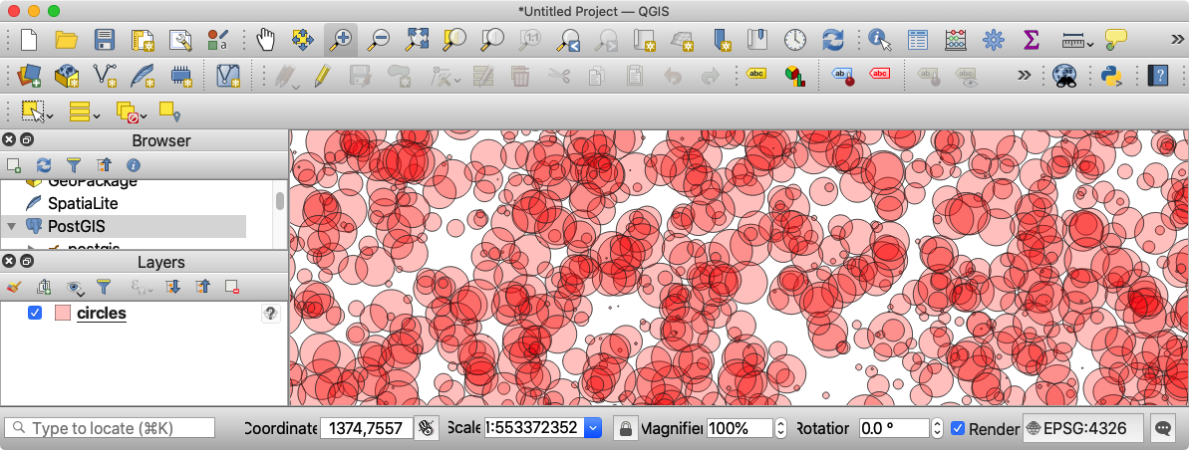
Download QGIS?
Section 1 - Welcome
https://qgis.org/

Slide 6
Ready?
Section 1 - Welcome

Slide 7
Section 2 - Introduction
Section 2 - Introduction

Slide 8
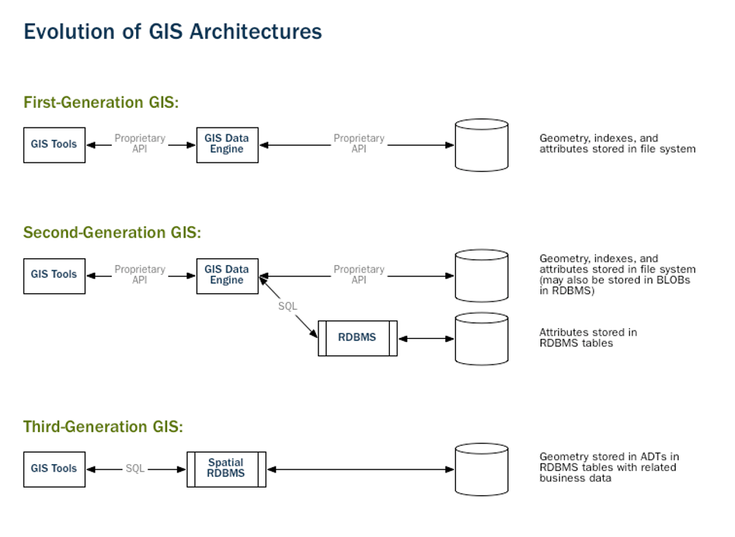
Section 2 - Introduction
Notes:
1st generation: ARC/INFO. All spatial and attribute data locked in proprietary “GIS system”. Makes good use of meagre computing power of the era, but very hard to integrate with other business systems. Results in the organizational “GIS silo” which is still a feature of many institutions.
2nd generation: ARC/ORACLE, and other “connect local GIS data to remote enterprise database” systems. Retain all spatial data in proprietary formats and software, but call out to business systems to get the latest attribute data. Resulted in many bodgey applications that flipped between GIS database software and desktop database clients.
3rd generation: Spatial data migrates out to the database to live next to the business data. “Spatial is not special” it is just another column in the business database, so all tools can easily work with it using the same language they use for other business data management: SQL.

Slide 9
What is a database?
Section 2 - Introduction
System for storage and random access of relationally (tables of rows and columns) structured data, providing the following capabilities for that data.
Data Types
number, date, and string
Indexes
b-tree, hash
Functions
strlen(string), pow(float, float), now()

Slide 10
What is a spatial database?
Section 2 - Introduction
System for storage and random access of relationally (tables of rows and columns) structured data, providing the following capabilities for that data.
Data Types including Spatial Types
number, date, string, geometry, geography and raster
Indexes including Spatial Indexes
b-tree, hash, rtree, quadtree
Functions including Spatial Functions
strlen(string), pow(float, float), now(), ST_Area(), ST_Distance()

Slide 11
Spatial databases store and manipulate spatial objects like any other object in the database.
Section 2 - Introduction

Slide 12
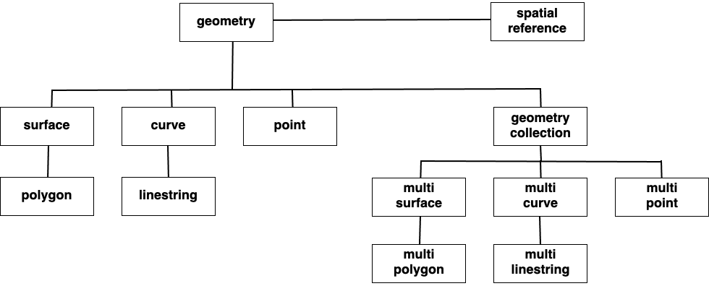
Spatial Types
Section 2 - Introduction

Slide 13
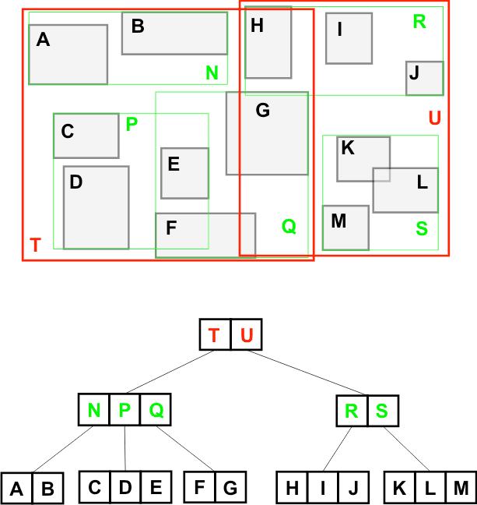
Spatial Indexes
Section 2 - Introduction
This R-Tree organizes the spatial objects so that a spatial search is a quick walk through the tree.
To find what object contains ?
The system first checks if it is in T or U (T)
Then it checks if it is in N, P or Q (P)
Then it checks if it is in C, D or E (D)
Only 8 boxes have to be tested. A full table scan would require all 13 boxes to be tested. The larger the table, the more powerful the index is.

Slide 14
Spatial Functions
Section 2 - Introduction
For example:
ST_GeometryType(geometry) → text
ST_Area(geometry) → float
ST_Distance(geometry, geometry) → float
ST_Buffer(geometry, radius) → geometry
ST_Intersection(geometry, geometry) → geometry
ST_Union([geometry]) → geometry
Notes:
Functions: manipulate data during a query,
an ordinary database concatenates strings, performs hash operations on strings, does MATH on numbers, and extracts information from dates. A spatial database provides a complete set of functions for analyzing geometric components, determining spatial relationships, and manipulating geometries.

Slide 15




What is PostGIS?
Section 2 - Introduction
CREATE EXTENSION
postgis;
Notes:
What people call “PostGIS” is actually just a combination of the PostgreSQL relational database, which provides all the standard database features (standard types, functions, indexes) and the PostGIS “extension” to PostgreSQL which adds in the spatial types, spatial functions and spatial indexes. So any software that “works with PostGIS” works with PostgreSQL, and vice versa.

Slide 16
What is PostgreSQL?
Section 2 - Introduction
Enterprise RDBMS
Functionally equivalent to Oracle / MSSQL
Multi-vendor open source community
Multi-platform support, and available on all clouds
Highly extensible by design
Types, functions, indexes, replication slots, foreign data, core hooks
What makes PostGIS possible
Notes:
So PostGIS depends a great deal on the PostgreSQL database within which it runs.
Inherits all the enterprise features of PgSQL: transactional integrity, rich security model, encrypted connections and authentication integrations
Provides the same feature set as Oracle or Microsoft SQL Server
Supported by a large, multi-vendor community. Not beholden to just one company, not going to be closed, not subject to whims of venture capitalists, has been around for 25 years as open source community project, still going strong.
Runs on platforms large and small. Windows, MacOS, Linux. Intel, ARM, Sparc, Power, MIPS. Cloud VMs and IBM mainframes.
Designed to prove computer science ideas about customizable and configurable databases. Allows “runtime” extension, so all core features are dynamically managed. PostGIS is an example of “custom type extension” as well as “custom functions” and “custom index methods”, in PostgreSQL, in fact the largest known and longest running extension of PostgreSQL. Other big extensions include TimescaleDB (for optized time series management) and Citus (for transactional database horizontal scaling)

Slide 17

Why not files?
Section 2 - Introduction
Shape, FGDB, GeoPackage?
No lingua franca for file access, every format has its own library
Database has SQL
Databases have JDBC, ODBC, others
Multi-user access to files results in either
Global file locking and performance issues (best case)
File corruption and data loss (worst case)
All database-style queries have to be implemented on client
Joins, aggregations, set-based logic
Notes:
Why not just store all the data in files? There’s even more modern formats like File Geodatabase or GeoPackage?
No! Databases provide standardization on access, both the language of query and the programming language connection abstraction. This makes it easy to hook everything from desktop GIS systems to data management scripts up to the same database. Non-GIS systems that know nothing about GIS formats can still hook up to databases like PostgreSQL and work against the data there.
Once you have more than one user of the data, shared file access becomes an issue. Most file formats are not designed for that. At best they will protect against corruption and be really slow. At worst you’ll destroy your data.
Finally as we’ll see in this course, the database doesn’t just provide read/write access, it provides a rich and powerful language for data query and transformation. If you were working with files, you’d have to hand code up all that logic.

Slide 18




PostGIS history
Section 2 - Introduction
&
2000
2001
2004
BC Watershed Atlas v1
BC Digital Road Atlas
BC Corporate Watersheds
“we need a spatial type!”
distance() indexes (v0.1)
“lightweight” geometry (v1.0)
Notes:
PostGIS grew out of the needs of a Victoria BC consulting company, doing large scale data management and analysis of natural resource data for the provincial government.
The watershed atlas summarized dozens of environmental statistics per watershed over the whole area. Managing that data in files was inefficient and error prone.
The Road Atlas requires province-wide data quality checks and random data access, simple analytics and indexes were required. The first public release happened after index and the first few functions were complete.
A second hydrology project with a much larger data set drove home the need for storage efficiency. The result of that rewrite was the eventual 1.0 release.
In 2008 the project moved to postgis.net and a full community-driven development model as the company stopped directly investing in further enhancements.

Slide 19








PostGIS reference users - government
Section 2 - Introduction

Slide 20







PostGIS reference users - private sector
Section 2 - Introduction

Slide 21

















PostGIS 3rd party integration
Desktop
Middle
Language
and more...
and more...
and more...
Section 2 - Introduction

Slide 22
Section 3 - Installation
Section 3 - Installation

Slide 23
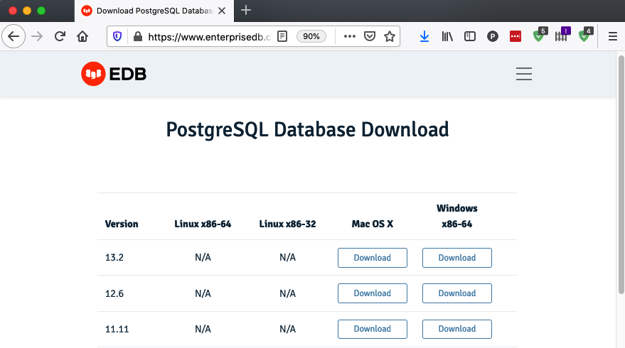
Microsoft Windows - postgresql.org/download/windows/
Section 3 - Installation

Slide 24
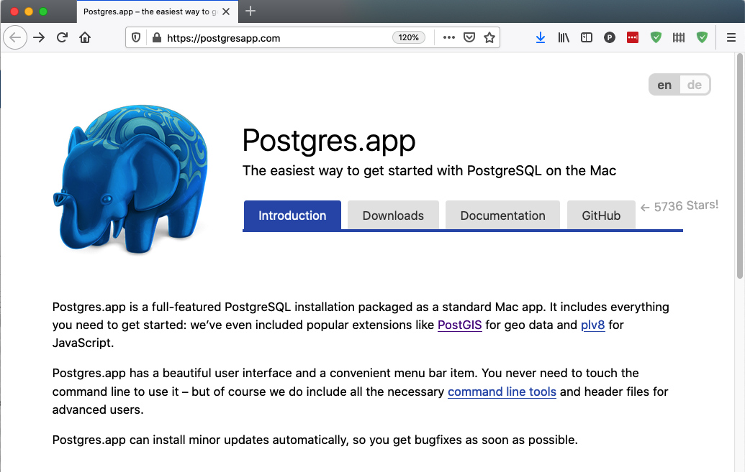
Apple MacOS - postgresapp.com
Section 3 - Installation

Slide 25

Linux - postgresql.org/download/
Section 3 - Installation
The postgresql.org site will walk you through the many options for selecting a Linux binary package, based on the version you want and the distribution.
Make sure you install the appropriate “postgis” package!
yum search postgis
apt-cache search postgis

Slide 26




Cloud - DBaaS includes PostGIS by default
Section 3 - Installation

Slide 27
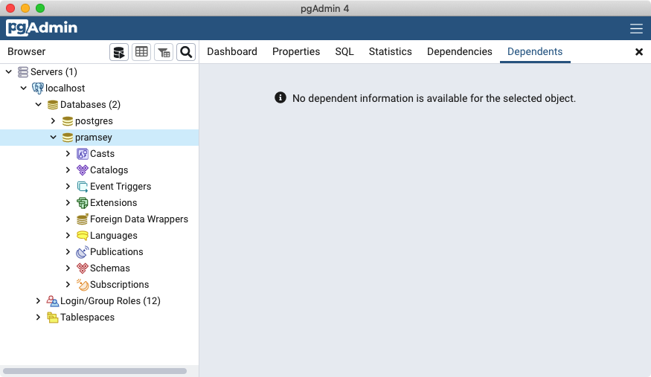
PgAdmin - pgadmin.org
Section 3 - Installation

Slide 28
Section 4 - Creating a Spatial Database
Section 4 - Creating a Spatial Database

Slide 29
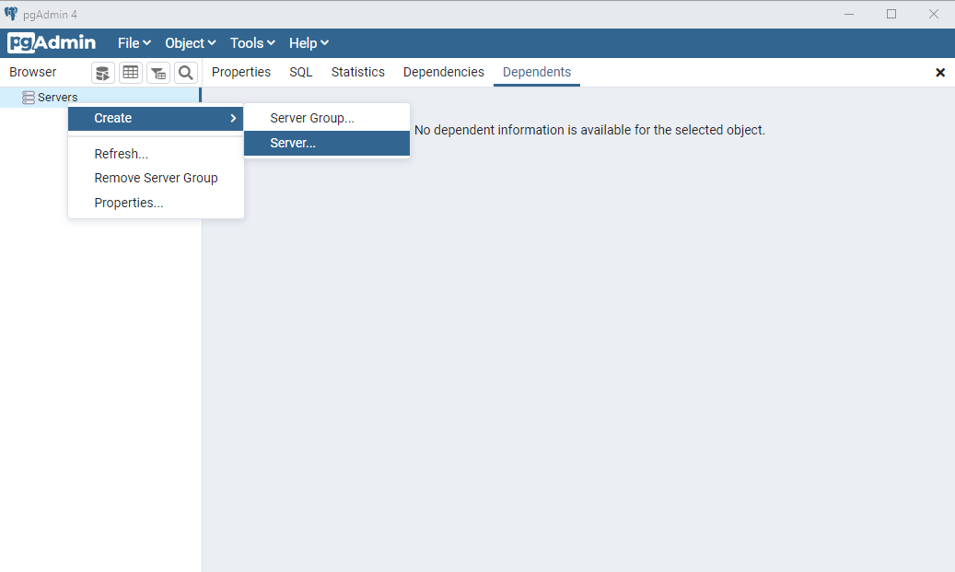
Section 4 - Creating a Spatial Database
Login

Slide 30
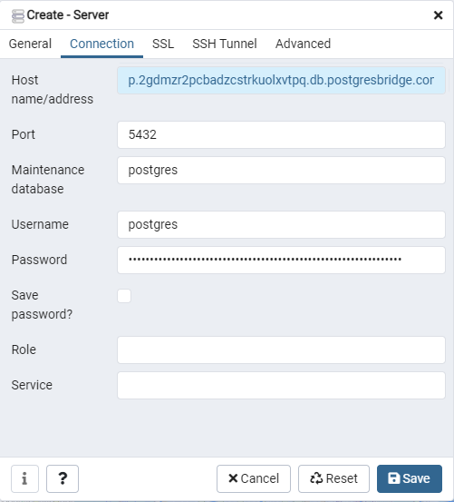
Section 4 - Creating a Spatial Database
Connection parameters
Host name/address
Port = 5432
Username = postgres
Password

Slide 31
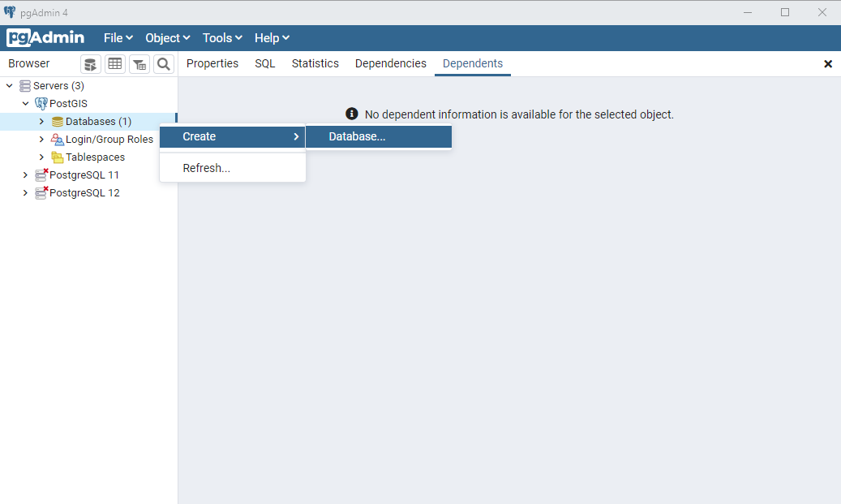
Section 4 - Creating a Spatial Database
New Database

Slide 32
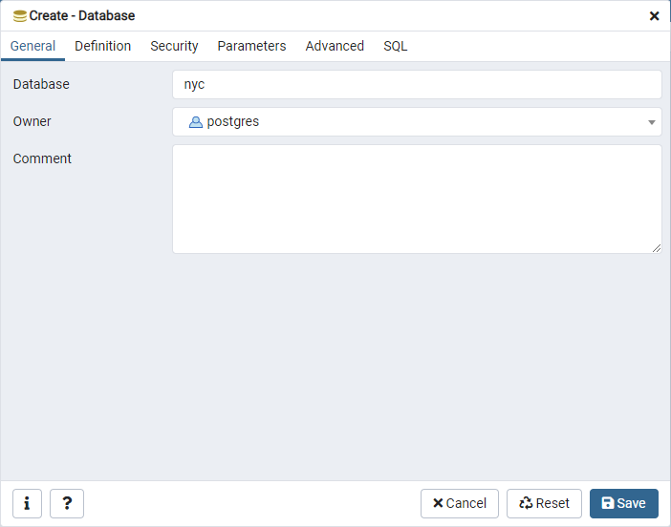
Section 4 - Creating a Spatial Database
New Database
Database = nyc
Owner = postgres

Slide 33
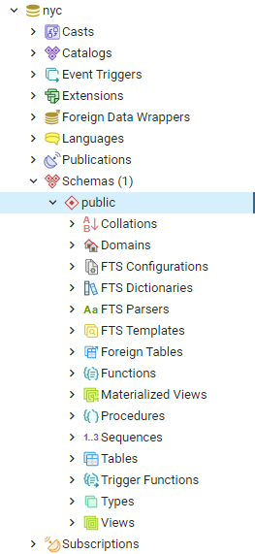
Section 4 - Creating a Spatial Database
Open "nyc" database

Slide 34

Section 4 - Creating a Spatial Database
Run SQL Query
Tools > Query Tool
CREATE EXTENSION postgis;

Slide 35
Section 4 - Creating a Spatial Database
Run SQL Query
SELECT postgis_full_version();

Slide 36
Section 5 - Loading Spatial Data
Section 5 - Loading Spatial Data

Slide 37
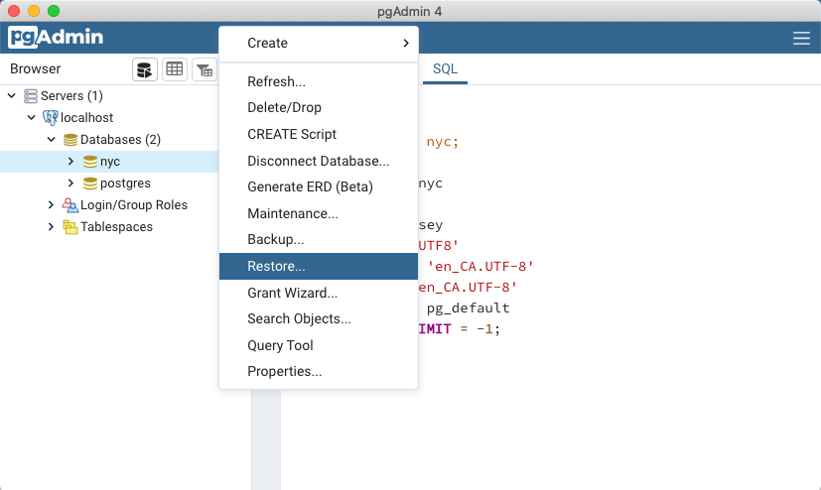
postgis-workshop/data/nyc_data.backup
Section 5 - Loading Spatial Data
Notes:
To simplify our data loading step, we will load the workshop data from a backup file and then review other options for loading data using the ogr2ogr and shp2pgsql data loading utilities.
Confirm that you can find the nyc_data.dmp file we will be loading.
Right click on “nyc” and then select “Restore…”

Slide 38
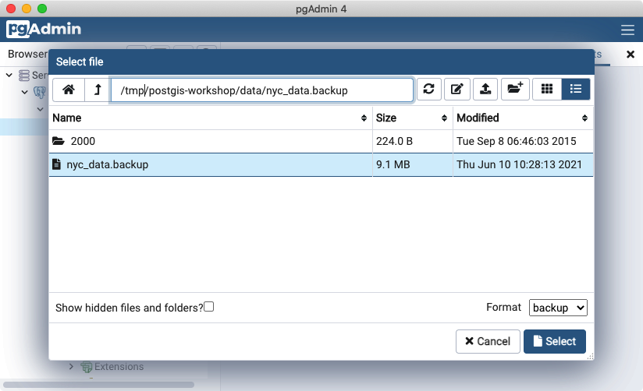
Section 5 - Loading Spatial Data
Notes:
Navigate to the nyc_data.dmp file.
Select the file!

Slide 39
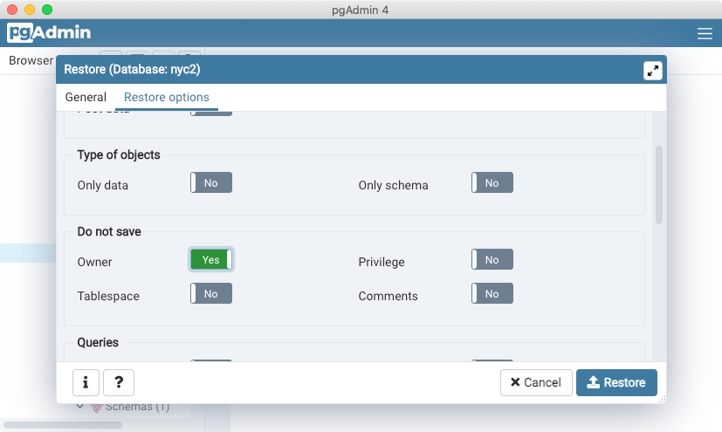
Section 5 - Loading Spatial Data
Notes:
Navigate to the restore options,
Flip the “Owner” slider to “Yes”
Hit “Restore”

Slide 40
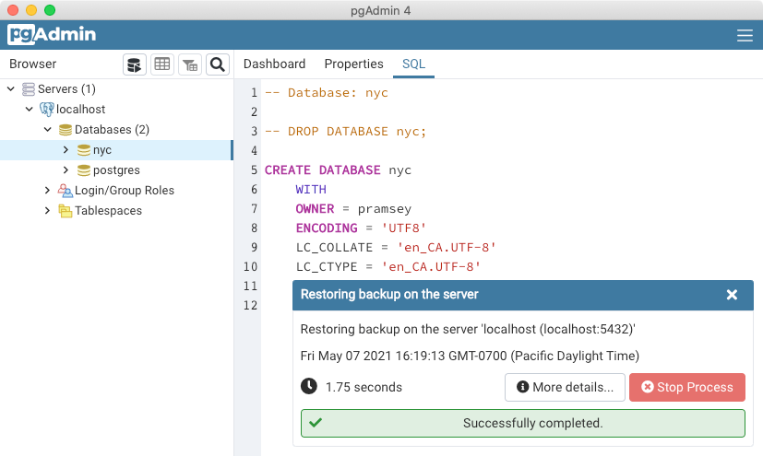
Section 5 - Loading Spatial Data
Notes:
The data restore will run.

Slide 41
Loading “GIS data files”
Section 5 - Loading Spatial Data
ogr2ogr
supports many formats
shp, fgdb, geojson, etc
supports many databases
sqlserver, oracle, mysql
many processing options
separate install
complex command line
connects directly to database
shp2pgsql
supports only shape file
supports only pgsql
minimal processing options
comes with postgis
simpler command line
generates SQL file to pass into the database
Notes:
The data restore will run.

Slide 42
ogr2ogr
Section 5 - Loading Spatial Data
new layer name
new layer type
ogr2ogr \
-nln nyc_census_blocks_2000 \
-nlt PROMOTE_TO_MULTI \
-lco GEOMETRY_NAME=geom \
-lco FID=gid \
-lco PRECISION=NO \
Pg:'dbname=nyc host=localhost user=postgres port=5432' \
nyc_census_blocks_2000.shp
geometry column name
pk name
full precision?
destination data
source data
Notes:
The ogr2ogr utility has a lot of command line options, and this is (honestly) the minimum needed to load a shape file into a standard lookup destination table.
This is all one big command. The backslashes are a way of having a single command appear on multiple lines.

Slide 43
What is a “shape file”?
Section 5 - Loading Spatial Data
nyc_streets.shp
The actual “shapes”, in a binary format
nyc_streets.dbf
The “attributes” of the streets, a spreadsheet of one row per shape with the non-spatial information (name, street number, city, etc)
nyc_streets.shx
An offset index. (Shape 5 begins at byte 1023 in the shp file, etc)
nyc_streets.prj
The spatial reference system of the data in WKT format.

Slide 44
nyc_streets.prj (EPSG:26918)
PROJCS["NAD_1983_UTM_Zone_18N",
GEOGCS["GCS_North_American_1983",
DATUM["D_North_American_1983",
SPHEROID["GRS_1980",6378137,298.257222101]],
PRIMEM["Greenwich",0],
UNIT["Degree",0.017453292519943295]],
PROJECTION["Transverse_Mercator"],
PARAMETER["latitude_of_origin",0],
PARAMETER["central_meridian",-75],
PARAMETER["scale_factor",0.9996],
PARAMETER["false_easting",500000],
PARAMETER["false_northing",0],
UNIT["Meter",1]]
Section 5 - Loading Spatial Data

Slide 45
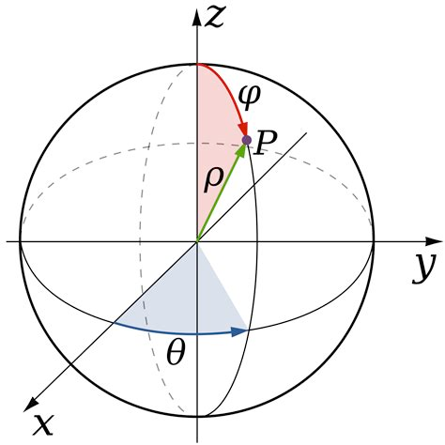
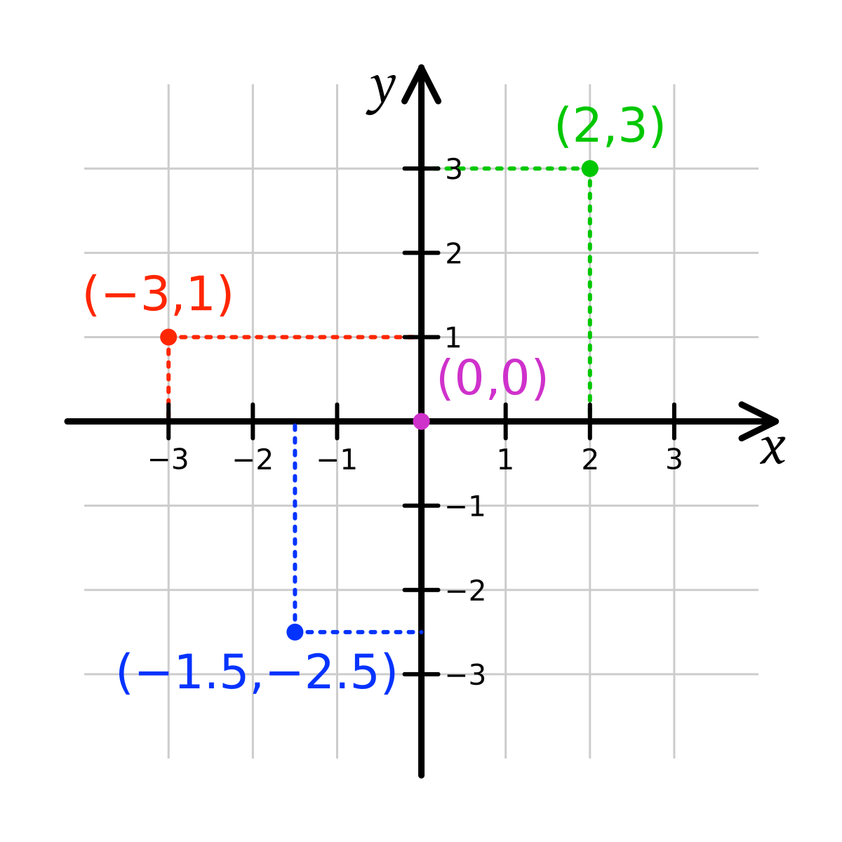
nyc_streets.prj (EPSG:26918)
Universal Transverse Mercator EPSG:26918
POINT(586020 4513147)
WGS 1984 EPSG:4326
POINT(-73.9808 40.7648)
Section 5 - Loading Spatial Data

Slide 46
shp2pgsql
Section 5 - Loading Spatial Data
Section 5 - Loading Spatial Data
dump format
build spatial index
shp2pgsql \
-D \
-I \
-s 26918 \
nyc_census_blocks_2000.shp \
nyc_census_blocks_2000 \
| psql dbname=nyc user=postgres host=localhost
spatial reference id of data
source file
destination table name
destination database connection
Notes:
The shp2pgsql command has fewer required options for a data load, but note this command has two executables being run. shp2pgsql turns the shape file into SQL statements, which are then “piped” (see the vertical pipe at the start of the red line?) into the psql terminal monitor where they are send to the database and executed.

Slide 47
Section 6 - About our data
Section 6 - About our data

Slide 48
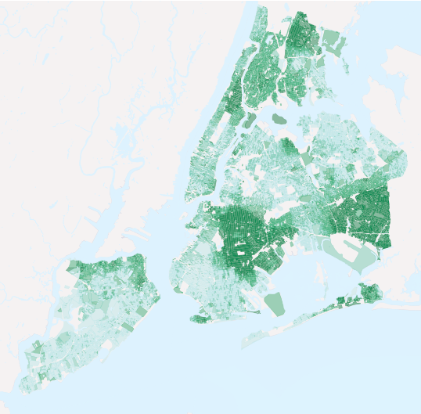
nyc_census_blocks
blkid
popn_total
popn_white
popn_black
popn_nativ
popn_asian
popn_other
boroname
geom
Section 6 - About our data
Notes:
These are 2010 census block with population count by race.
Any guesses as to how these data are color themed? This is Black population as a percentage of Total Population.
To get census data into GIS, you need to join two pieces of information: the actual data (text), and the boundary files (spatial). There are many options for getting the data, including downloading data and boundaries from the Census Bureau’s American FactFinder.

Slide 49
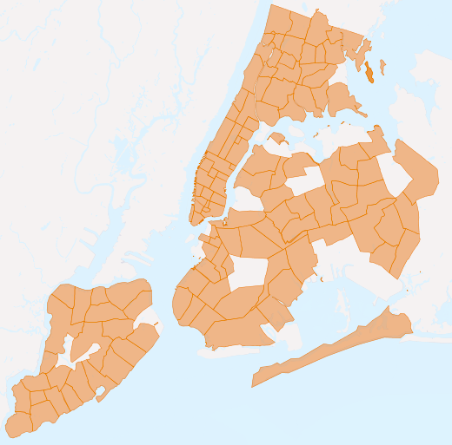
nyc_neighborhoods
name
boroname
geom
Section 6 - About our data
Notes:
The neighborhoods of New York City. These data were originally sourced from Zillow, they are based on observations of realty listings, and are not build up from census blocks or any other common base data. As such they make a good test for spatial data as the universal key to join different data layers.

Slide 50
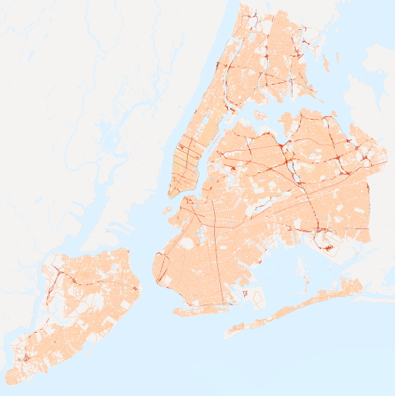
nyc_streets
name
oneway
type
geom
Section 6 - About our data
Notes:
This is an old center-line road network for the City of New York.
For each road, there is a name, a type, a one-way flag and a geometry.
The “type”distinguishes between local and arterial roads.
We will mostly use the name and the geometry.

Slide 51
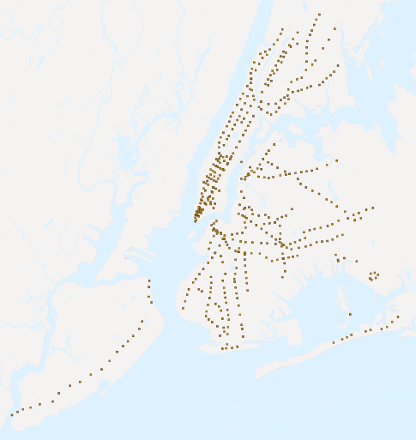
nyc_subway_stations
name
borough
routes
transfers
express
geom
Section 6 - About our data
Notes:
For each subway stop, a point. Some subway stations serve lots of subway lines (for example, Times Square) but each station still gets just one dot. Lines can be imputed by looking at all the stops that have the same routes.

Slide 52
nyc_census_sociodata
Section 6 - About our data
tractid | transit_total | transit_public
transit_private | transit_other | transit_time_mins
family_county | family_income_median | family_income_aggregate
edu_total | edu_no_highschool_dipl | edu_highscool_dipl
edu_college_dipl | edu_graduate_dipl
Notes:
The nyc_census_sociodata is in a SQL file that we will load separately later in the workshop.
It has socio-economic data on a census tract basis, for education, income and transit/commuting variables. For each category (transit, edu) there is a normalizing _total variable to go with the category.

Slide 53
Section 7 - Simple SQL
Section 7 - Simple SQL
Notes:
Before we start on spatial SQL, here is a very short intro on non-spatial SQL and running it in the PgAdmin user interface.
You don’t need to answer all the exercises in this workshop, or write all the SQL, but it is helpful to run all the SQL in the example file, so open that up so you can follow along just by pasting in examples as we get to them so you can see the answers.

Slide 54

Section 7 - Simple SQL
SELECT name
FROM nyc_neighborhoods;

Slide 55
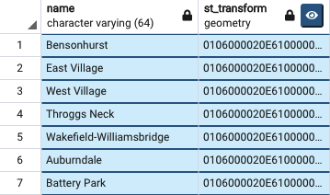
PgAdmin and Maps
Section 7 - Simple SQL
PgAdmin includes a magic “map” button which is fun to use to visualize geometric outputs. If the data are in “geographics” (EPSG:4326) then it will place a base map underneath the data. This can be pretty.
To see a map with your output, wrap it in ST_Transform(geom, 4326). This will make more sense as we work through the materials.
SELECT name, ST_Transform(geom, 4326)
FROM nyc_neighborhoods;
Notes:
For each subway stop, a point. Some subway stations serve lots of subway lines (for example, Times Square) but each station still gets just one dot. Lines can be imputed by looking at all the stops that have the same routes.

Slide 56
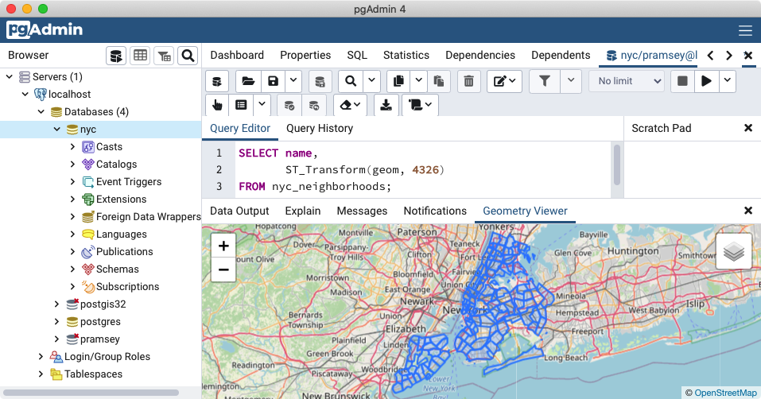
Section 7 - Simple SQL

Slide 57
Four Verbs of SQL
Section 7 - Simple SQL
SELECT
returns rows in response to a query
INSERT
adds new rows to a table
UPDATE
alters existing rows in a table
DELETE
removes rows from a table
Notes:
*at some point, mention that some queries require built-in functions

Slide 58
What are ... the names of all the neighborhoods in Brooklyn?
Section 7 - Simple SQL
SELECT name
FROM nyc_neighborhoods
WHERE boroname = 'Brooklyn';

Slide 59
What is the number of letters in the names of all the neighborhoods in Brooklyn?
Section 7 - Simple SQL
SELECT char_length(name)
FROM nyc_neighborhoods
WHERE boroname = 'Brooklyn';
Notes:
char_length() is an example of a built-in string function in PostgreSQL ST_Transform

Slide 60
What is the average number of letters and standard deviation of number of letters in the names of all the neighborhoods in Brooklyn?
Section 7 - Simple SQL
SELECT avg(char_length(name)), stddev(char_length(name))
FROM nyc_neighborhoods
WHERE boroname = 'Brooklyn';

Slide 61
What is the average number of letters in the names of all the neighborhoods in New York City, reported by borough?
Section 7 - Simple SQL
SELECT boroname, avg(char_length(name))
FROM nyc_neighborhoods
GROUP BY boroname;

Slide 62


Section 8 - Simple SQL Exercises
Section 8 - Simple SQL Exercises

Slide 63
How many records are in the nyc_streets table?
Section 8 - Simple SQL Exercises
SELECT Count(*)
FROM nyc_streets;

Slide 64
How many streets in NYC start with ‘B’?
Section 8 - Simple SQL Exercises
SELECT Count(*)
FROM nyc_streets WHERE name LIKE 'B%';

Slide 65
What is the population of NYC?
Section 8 - Simple SQL Exercises
SELECT Sum(popn_total) AS population
FROM nyc_census_blocks;

Slide 66
What is the population of ‘The Bronx’?
Section 8 - Simple SQL Exercises
SELECT Sum(popn_total)
FROM nyc_census_blocks WHERE boroname = 'The Bronx';

Slide 67
How many neighborhoods are in each borough?
Section 8 - Simple SQL Exercises
SELECT boroname, Count(*)
FROM nyc_neighborhoods
GROUP BY boroname;

Slide 68
For each borough in NYC, what is percentage of the population is “white”?
Section 8 - Simple SQL Exercises
SELECT boroname, 100.0 * Sum(popn_white) /
Sum(popn_total) AS pct
FROM nyc_census_blocks GROUP BY boroname;

Slide 69
Section 9 - Geometries
Section 9 - Geometries

Slide 70
Spatial Types
Section 9 - Geometries

Slide 71
Creating a table with geometry
Section 9 - Geometries
CREATE TABLE geometries
(
name varchar,
geom geometry
);
Notes:
In pgAdmin,
Select the nyc database
Open the SQL query tool.
Paste the example SQL code into the pgAdmin SQL Editor window (removing any text that may be there by default) and then
Execute.

Slide 72
Creating a table with geometry
Section 9 - Geometries
INSERT INTO geometries (name, geom) VALUES
('Point', 'POINT(0 0)'),
('Linestring', 'LINESTRING(0 0, 1 1, 2 1, 2 2)'),
('Polygon', 'POLYGON((0 0, 1 0, 1 1, 0 1, 0 0))'),
('PolygonWithHole', 'POLYGON((...))'),
('Collection', 'GEOMETRYCOLLECTION(...)');
Notes:
The above example CREATEs a table (geometries) then
INSERTs five geometries: a point, a line, a polygon, a polygon with a hole, and a collection.

Slide 73
Creating a table with geometry
Section 9 - Geometries
SELECT name, ST_AsText(geom)
FROM geometries;

Slide 74
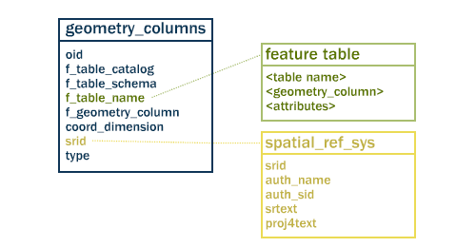
Table Relationships
Section 9 - Geometries
Notes:
two tables to track and report on the geometry types available in a given database.
spatial_ref_sys, defines all the spatial reference systems known to the database
geometry_columns, provides a listing and basic details of all “features”

Slide 75
geometry_columns
Section 9 - Geometries
SELECT * FROM geometry_columns
Notes:
By querying this table, GIS clients and libraries can determine what to expect when retrieving data
and can perform any necessary projection, processing or rendering without needing to inspect each geometry.

Slide 76
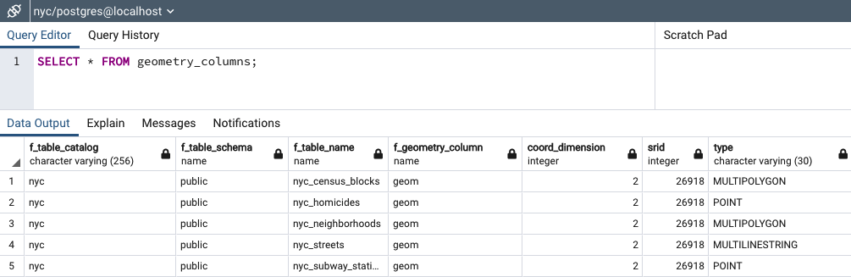
geometry_columns
Section 9 - Geometries
Notes:
f_table_name: fully qualified name of the feature table
f_geometry_column: name of the column that geometry containing column
– for feature tables with multiple geometry columns, there will be one record for each.
coord_dimension : 2-, 3- or 4-dimensional
srid: Spatial Reference system identifier
type: defines the type of geometry e.g., Point and Linestring

Slide 77
Metadata functions
Section 9 - Geometries
SELECT
name,
ST_GeometryType(geom),
ST_NDims(geom),
ST_SRID(geom)
FROM geometries;
Notes:
Our example table contains a mixture of different geometry types.
We can collect general information about each object using functions that read the geometry metadata.
GeometryType, NDims, SRID

Slide 78
Metadata functions
Section 9 - Geometries
name | st_geometrytype | st_ndims | st_srid
-----------------+-----------------------+----------+---------
Point | ST_Point | 2 | 0
Linestring | ST_LineString | 2 | 0
Polygon | ST_Polygon | 2 | 0
PolygonWithHole | ST_Polygon | 2 | 0
Collection | ST_GeometryCollection | 2 | 0
Notes:
ST_GeometryType(geometry) returns the type of the geometry
ST_NDims(geometry) returns the number of dimensions of the geometry
ST_SRID(geometry) returns the spatial reference identifier number of the geometry

Slide 79
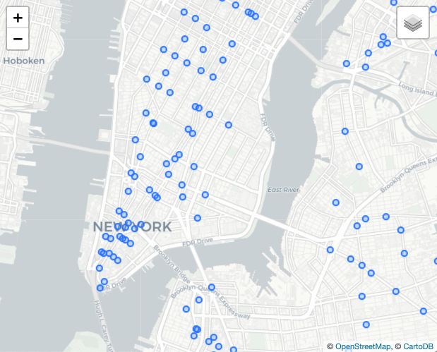
Points
Section 9 - Geometries
“Point” or “MultiPoint”, representing one or more 0-dimensional locations.
New York city subway stations, stop signs, man holes, address points, current locations of vehicles, might all use a “Point” geometry type.

Slide 80
Points
Section 9 - Geometries
SELECT ST_AsText(geom)
FROM geometries
WHERE name = 'Point'; POINT(0 0)
Notes:
Our example table contains a mixture of different geometry types.
We can collect general information about each object using functions that read the geometry metadata.
GeometryType, NDims, SRID

Slide 81
Points
Section 9 - Geometries
SELECT
ST_X(geom),
ST_Y(geom)
FROM geometries
WHERE name = 'Point' 0 0
Notes:
Our example table contains a mixture of different geometry types.
We can collect general information about each object using functions that read the geometry metadata.
GeometryType, NDims, SRID

Slide 82
Points
Section 9 - Geometries
SELECT
name,
ST_AsText(geom)
FROM nyc_subway_stations
LIMIT 1; Cortlandt St | POINT(583521 4507077)
Notes:
Our example table contains a mixture of different geometry types.
We can collect general information about each object using functions that read the geometry metadata.
GeometryType, NDims, SRID

Slide 83
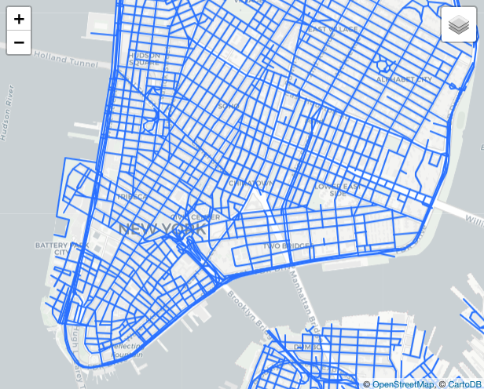
LineStrings
Section 9 - Geometries
“LineString” or “MultiLineString”, representing one or more 1-dimensional objects.
Streets, streams, bus routes, power lines, driven routes, highways, might all use a “LineString” geometry type.

Slide 84
LineStrings
Section 9 - Geometries
SELECT ST_AsText(geom)
FROM geometries
WHERE name = 'Linestring'; LINESTRING(0 0,1 1,2 1,2 2)
Notes:
Our example table contains a mixture of different geometry types.
We can collect general information about each object using functions that read the geometry metadata.
GeometryType, NDims, SRID

Slide 85
LineStrings
Section 9 - Geometries
SELECT ST_Length(geom)
FROM geometries
WHERE name = 'Linestring';
3.41421356237309
Notes:
Our example table contains a mixture of different geometry types.
We can collect general information about each object using functions that read the geometry metadata.
GeometryType, NDims, SRID

Slide 86
LineStrings
Section 9 - Geometries
ST_Length(linestring)
ST_StartPoint(linestring)
ST_EndPoint(linestring)
ST_NumPoints(linestring)

Slide 87
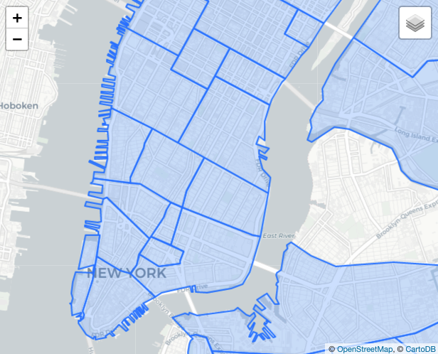


Polygons
Section 9 - Geometries
“Polygon” or “MultiPolygon”, representing one or more 2-dimensional objects.
Census areas, parcels, counties, countries, neighborhoods, zoning areas, watersheds, and more.

Slide 88
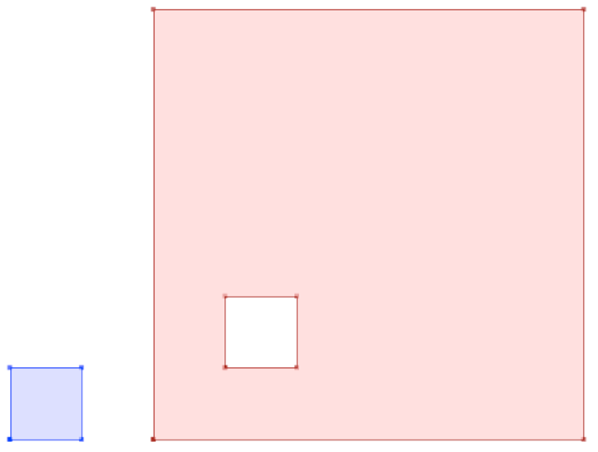
Polygons
Section 9 - Geometries
Notes:
The first polygon has only one ring.
The second one has an interior “hole”.
Most graphics systems include the concept of a “polygon”,
but GIS systems are relatively unique in allowing polygons to explicitly have holes.

Slide 89
Polygons
Section 9 - Geometries
SELECT ST_AsText(geom)
FROM geometries
WHERE name LIKE 'Polygon%';
POLYGON((0 0, 1 0, 1 1, 0 1, 0 0))
POLYGON((0 0, 10 0, 10 10, 0 10, 0 0), (1 1, 1 2, 2 2, 2 1, 1 1))
Notes:
Rather than using an = sign in our WHERE clause,
we are using the LIKE operator to carry out a string matching operation.

Slide 90
Polygons
Section 9 - Geometries
ST_Area(polygon)
ST_NumInteriorRings(polygon)
ST_ExteriorRing(polygon)
ST_InteriorRing(polygon,n)
ST_Perimeter(polygon)
Notes:
ST_Area(geometry) returns the area of the polygons
ST_NumInteriorRings(geometry) returns the number of interior rings (usually 0, more of there are holes)
ST_ExteriorRing(geometry) returns the outer ring as a linestring
ST_InteriorRingN(geometry,n) returns a specified interior ring as a linestring
ST_Perimeter(geometry) returns the length of all the rings

Slide 91
Polygons
Section 9 - Geometries
SELECT name, ST_Area(geom)
FROM geometries
WHERE name LIKE 'Polygon%';
Polygon | 1
PolygonWithHole | 99
Notes:
Calculate the area of our polygons using the area function
Note that the polygon with a hole has an area that is the area of the outer shell
(a 10x10 square) minus the area of the hole (a 1x1 square).

Slide 92
Geometry Formats
Section 9 - Geometries
ST_As...
Text, EWKT, GML, KML, SVG, GeoJSON, Binary, EWKB
ST_GeomFrom...
Text, EWKT, GML, KML, GeoJSON, Binary, EWKB
Notes:
Geometries are stored on disk in a format only used by PostGIS.
External programs to insert and retrieve useful geometries, they need to be converted into a format that other applications can understand.
PostGIS supports emitting and consuming geometries in a large number of formats:
These are called Geometry Constructors
WKT: Well-known text Can refer either to the text representation of geometries, with strings starting “POINT”, “LINESTRING”, “POLYGON”, etc. Or can refer to the text representation of a CRS, with strings starting “PROJCS”, “GEOGCS”, etc. Well-known text representations are OGC standards, but do not have their own specification documents. The first descriptions of WKT (for geometries and for CRS) appeared in the SFSQL 1.0 specification.
WKB: Well-known binary Refers to the binary representation of geometries described in the Simple Features for SQL specification (SFSQL).
GML: Geography Markup Language. GML is the OGC standard XML grammar for expressing geographical features. GML serves as a modeling language for geographic systems as well as an open interchange format for geographic transactions on the Internet. As with most XML based grammars, there are two parts to the grammar – the schema that describes the document and the instance document that contains the actual data.
JSON: Javascript Object Notation a text format that is very fast to parse in Javascript virtual machines. In spatial, the extended specification for GeoJSON is commonly used.
GeoJSON: A format for encoding a variety of geographic data structures. A GeoJSON object may represent a geometry, a feature, or a collection of features. GeoJSON supports the following geometry types: Point, LineString, Polygon, MultiPoint, MultiLineString, MultiPolygon, and GeometryCollection. Features in GeoJSON contain a geometry object and additional properties, and a feature collection represents a list of features.
KML: Keyhole Markup Language the spatial XML format used by Google Earth. Google Earth was originally written by a company named “Keyhole”, hence the (now obscure) reference in the name.

Slide 93
Geometry Formats
Section 9 - Geometries
SELECT ST_AsText(
ST_GeometryFromText(
'LINESTRING(0 0 0,1 0 0,1 1 2)'
)
);
LINESTRING Z (0 0 0,1 0 0,1 1 2)
Notes:
Extended Well-known Text Representation. This format embeds the SRID to the geometry.
3- or 4-dimensional geometries

Slide 94
Geometry Formats
Section 9 - Geometries
SELECT ST_AsGeoJSON(
ST_GeomFromGML(
'<gml:Point>
<gml:coordinates>
1,1
</gml:coordinates>
</gml:Point>'
));
{"type":"Point","coordinates":[1,1]}

Slide 95
All roads lead to Rome … (Geometry construction)
Section 9 - Geometries
SELECT ST_AsEWKT(
ST_GeomFromText('POINT(1 1)', 4326)
);
SRID=4326;POINT(1 1)
Notes:
There are many many ways to create a geometry from a pair of coordinates.
In general, you need to provide both the coordinate information and the SRID, so the system can correctly locate the geometry on the earth.
This example uses the ST_GeomFromText() constructor.

Slide 96
All roads lead to Rome … (Geometry construction)
Section 9 - Geometries
SELECT ST_AsEWKT(
ST_SetSRID(
ST_GeomFromText('POINT(1 1)'),
4326
)
);
SRID=4326;POINT(1 1)
Notes:
There is also a one-parameter ST_GeomFromText() function, that sets the SRID to 0. So then we wrap it in an ST_SetSRID() function to supply the SRID afterwards.

Slide 97
All roads lead to Rome … (Geometry construction)
Section 9 - Geometries
SELECT ST_AsEWKT(
ST_SetSRID(
ST_MakePoint(1, 1),
4326
)
);
SRID=4326;POINT(1 1)
Notes:
Sometimes it is nice to avoid the overhead of parsing text, particularly if you are just creating a point.The ST_MakePoint() function, with the ST_SetSRID() function can generate a new point without parsing text inputs. Building a POINT with string concatenation and then parsing it is a potential SQL injection vector.

Slide 98
All roads lead to Rome … (Geometry construction)
Section 9 - Geometries
SELECT ST_AsEWKT(
ST_SetSRID(
'POINT(1 1)'::geometry,
4326
)
);
SRID=4326;POINT(1 1)
Notes:
PostgreSQL has a type casting notation, the “::” operator that applies the desired cast, in this case from a text string directly to a geometry. As long as the text is a valid WKT or HEXWKB string, casting directly from text works automatically. There’s no SRID in the text, so we have to add it after using ST_SetSRID().

Slide 99
All roads lead to Rome … (Geometry construction)
Section 9 - Geometries
SELECT ST_AsEWKT(
'SRID=4326;POINT(1 1)'::geometry
);
SRID=4326;POINT(1 1)
Notes:
The “extended well-known-text” format includes a slot for the SRID, so you can go from text to a geometry-with-SRID in one step, casting from EWKT to geometry.

Slide 100
Section 10 - Geometry Exercises
Section 10 - Geometry Exercises

Slide 101
What is the area of the ‘West Village’ neighborhood?
Section 10 - Geometry Exercises
SELECT ST_Area(geom)
FROM nyc_neighborhoods
WHERE name = 'West Village';
1044614.5296486

Slide 102
What is the geometry type of ‘Pelham St’? The length?
Section 10 - Geometry Exercises
SELECT ST_GeometryType(geom), ST_Length(geom)
FROM nyc_streets
WHERE name = 'Pelham St';
ST_MultiLineString | 50.323

Slide 103
What is the GeoJSON representation of ‘Broad St’ subway station?
Section 10 - Geometry Exercises
SELECT ST_AsGeoJSON(geom, 0)
FROM nyc_subway_stations
WHERE name = 'Broad St';
{"type":"Point", "crs":{"type":"name", "properties":{"name":"EPSG:26918"}}, "coordinates":[583571,4506714]}

Slide 104
What is the total length of streets (in kilometers) in New York City?
Section 10 - Geometry Exercises
SELECT Sum(ST_Length(geom)) / 1000
FROM nyc_streets;
10418.904717199996

Slide 105
What is the area of Manhattan in acres?
Section 10 - Geometry Exercises
SELECT Sum(ST_Area(geom)) / 4047
FROM nyc_census_blocks
WHERE boroname = 'Manhattan'; 14601.3987215548

Slide 106
What is the most westerly subway station?
Section 10 - Geometry Exercises
SELECT ST_X(geom), name
FROM nyc_subway_stations
ORDER BY ST_X(geom) LIMIT 1;
563292.1 | Tottenville

Slide 107
Section 11 - Spatial Relationships
Section 11 - Spatial Relationships

Slide 108
Spatial Relationship Functions
Section 11 - Spatial Relationships
ST_Intersects(A, B)
ST_DWithin(A, B, d)
ST_Distance(A, B)
ST_Within, ST_Contains(A, B)
ST_Equals(A, B)
ST_Touches(A, B)
ST_Disjoint, ST_Crosses, ST_Overlaps(A, B)
Common
Uncommon

Slide 109
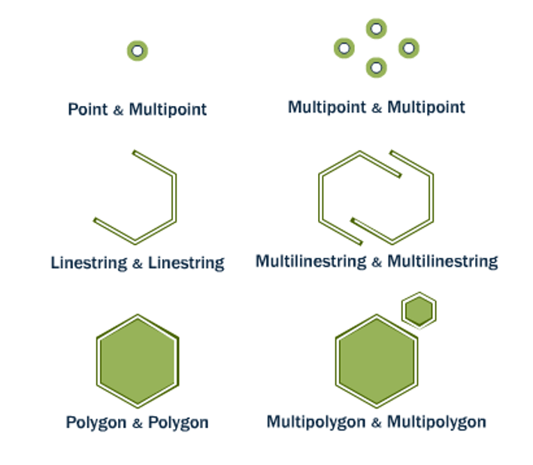
ST_Equals(A, B) ST_OrderingEquals(A, B)
Section 11 - Spatial Relationships
Equals tests that A and B cover the same space, regardless of representation differences (extra vertices, order of vertices). OrderingEquals insists on structural identity.
Notes:
Looking for exact matches is actually relatively rare in geospatial (it’s more common to look for “nearby” or “interacting” things), but when you need to search, the equal and equals exact functions are there. Exact structural equality can be important searching for directed roads in a network, where direction of digitization is meaningful. Equality without exact representation is useful for finding things like polygons, where the order of rings and start/end of rings isn’t important, but the area of coverage is.

Slide 110
What is geometry of Broad Street subway station?
Section 11 - Spatial Relationships
SELECT name, geom
FROM nyc_subway_stations
WHERE name = 'Broad St';
0101000020266900000EEBD4CF27CF2141BC17D69516315141

Slide 111
What subway station record matches that geometry?
Section 11 - Spatial Relationships
SELECT name
FROM nyc_subway_stations
WHERE ST_Equals(
geom, '0101000020266900000EEBD4CF27CF2141BC17D69516315141' );
Broad St

Slide 112
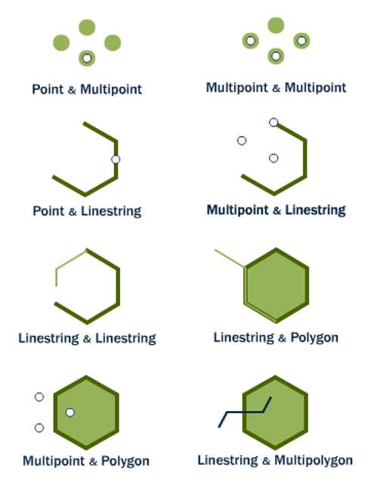
ST_Intersects(A, B) ST_Disjoint(A, B)
Section 11 - Spatial Relationships
Intersects and disjoint are opposites. Any kind of interactions between two shapes is an intersection, and implies the pair are not disjoint, and vice versa.
A intersects B ⇒ A not disjoint B
A disjoint B ⇒ A not intersects B
Notes:
The most widely used “spatial predicate” (spatial relationship with a boolean return value), intersects is for queries looking for “any objects with interaction”. Objects that touch, overlap, contain or are contained, they all intersect. Objects with zero distance between each other intersect. Objects with greater than zero, are disjoint. Find all the customer locations that intersect the service area of this store. Find all the airplane tracks that intersect the forbidden flight zone. Find all the parcels that intersect the fire hall service zone.

Slide 113
What is the well-known text (WKT) of Broad Street subway station?
Section 11 - Spatial Relationships
SELECT name, ST_AsText(geom, 0)
FROM nyc_subway_stations
WHERE name = 'Broad St';
POINT(583571 4506714)

Slide 114
What neighborhood intersects that subway station?
Section 11 - Spatial Relationships
SELECT name, boroname
FROM nyc_neighborhoods
WHERE ST_Intersects(
geom, ST_GeomFromText( 'POINT(583571 4506714)', 26918));
Financial District | Manhattan

Slide 115
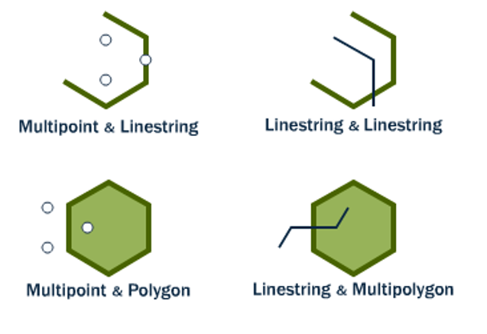
ST_Crosses(A, B)
Section 11 - Spatial Relationships
Mostly used to test linestrings, which can be said to cross when their interiors have interactions.
When linestrings cross polygon boundaries, the crosses condition is also true.
Notes:
Crosses is infrequently used because it mostly has intuitive sense for lines (though it is defined for all type combinations as shown in the diagram). In the case where lines cross at their mid-point, is an “un-noded” intersection between lines. Sometimes people are interested in un-noded crossings because they want to fix them (many road networks are expected to be “fully noded”. Sometimes people are interested in un-noded crossings for what they represent (some road networks use them to represent things like over- and under-passes).

Slide 116

ST_Overlaps(A, B)
Section 11 - Spatial Relationships
Shapes overlap when their interiors interact with each other and also with the exterior of the shape.
So objects that are contained or within do not overlap, overlaps is what normal people might call “partial overlap”.
Notes:
Overlaps is probably the least used predicate. It’s quite specific, the objects share some of their interiors but neither shares all of it’s interior. People might understand it more as a “partial overlap”.

Slide 117
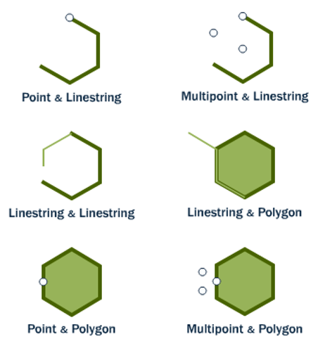
ST_Touches(A, B)
Section 11 - Spatial Relationships
Shapes touch when their boundaries interact but their interiors do not. End points for lines, exterior rings for polygons. Usually used for testing that polygons have ring-touching only.

Slide 118
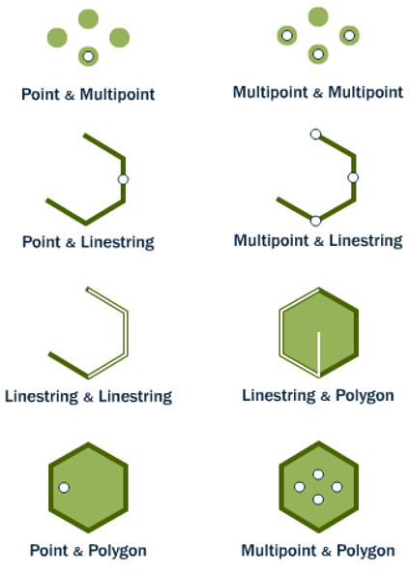
ST_Within(A, B) ST_Contains(B, A)
Section 11 - Spatial Relationships
Within and contains are about objects being fully inside. One important caveat, for both functions an object on the boundary is not considered within. So a point on the outer ring of a polygon is not within the polygon.

Slide 119
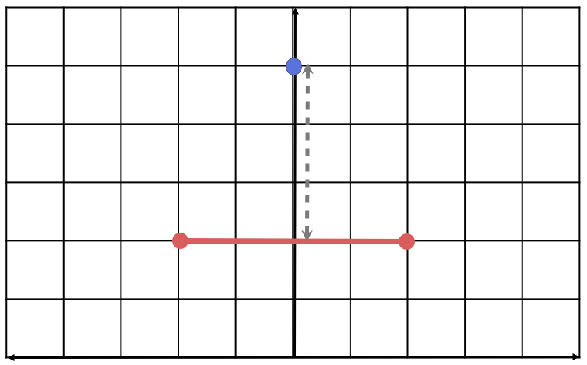
ST_Distance(A, B)
Section 11 - Spatial Relationships
Returns the shortest distance between the two geometries, in this case the distance from the point to the line mid-point.

Slide 120
ST_Distance(A, B)
Section 11 - Spatial Relationships
SELECT ST_Distance(
'POINT(0 5)'::geometry,
'LINESTRING(-2 2, 2 2)'::geometry );
3

Slide 121
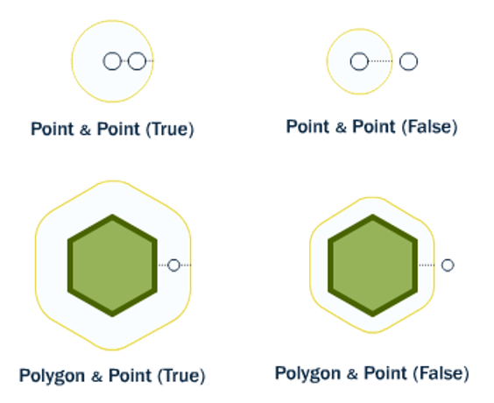
ST_DWithin(A, B, R)
Section 11 - Spatial Relationships
Index-enabled radius search function. True when the distance from geometry A to geometry B is less than radius R. False otherwise.
Use instead of ST_Distance(A, B) < R, in order to get benefit of spatial index.

Slide 122
What streets are within 10 meters of Broad Street subway station?
Section 11 - Spatial Relationships
SELECT name
FROM nyc_streets
WHERE ST_DWithin(
geom,
ST_GeomFromText('POINT(583571 4506714)',26918),
10
);

Slide 123
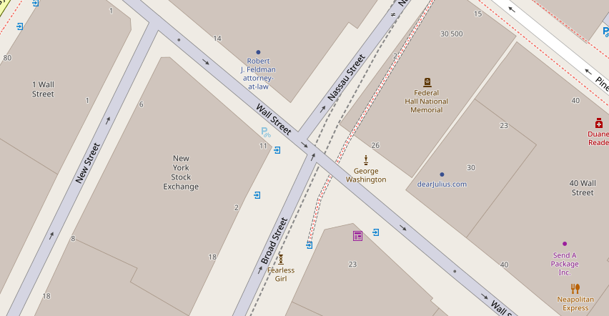

Section 11 - Spatial Relationships

Slide 124
Section 12 - Spatial Relationship Exercises
Section 12 - Spatial Relationship Exercises

Slide 125
What is the well-known text for the street 'Atlantic Commons'?
Section 12 - Spatial Relationship Exercises
SELECT ST_AsText(geom, 0)
FROM nyc_streets
WHERE name = 'Atlantic Commons'; MULTILINESTRING(( 586782 4504202, 586864 4504216))

Slide 126
What neighborhood and borough is 'POINT(586782 4504202)' in?
Section 12 - Spatial Relationship Exercises
SELECT name, boroname
FROM nyc_neighborhoods
WHERE ST_Intersects(
geom,
ST_GeomFromText( 'POINT(586782 4504202)', 26918)
);

Slide 127
How many people live within 50 meters of 'POINT(586782 4504202)'?
Section 12 - Spatial Relationship Exercises
SELECT Sum(popn_total)
FROM nyc_census_blocks
WHERE ST_DWithin(
geom,
ST_GeomFromText('POINT(586782 4504202)', 26918),
50 );

Slide 128
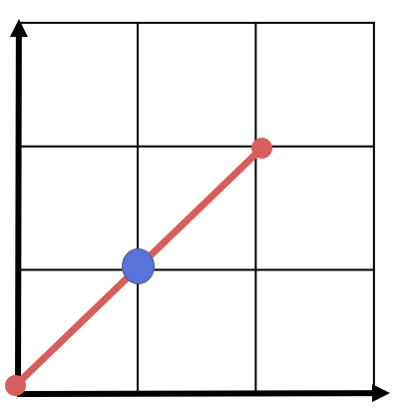
For ‘LINESTRING(0 0, 2 2)’ and ‘POINT(1 1)’ which of these relationships are true?
Intersects, Touches, Contains, Disjoint, Overlaps, Crosses, Within
A
B
Section 12 - Spatial Relationship Exercises

Slide 129
Point and Line Relationships
Section 12 - Spatial Relationship Exercises
SELECT
ST_Intersects(l,p), ST_Touches(l,p),
ST_Contains(l,p), ST_Disjoint(l,p),
ST_Overlaps(l,p), ST_Crosses(l,p),
ST_Within(l,p)
FROM (
SELECT
'LINESTRING(0 0, 2 2)'::geometry AS l,
'POINT(1 1)'::geometry AS p
) AS subquery;

Slide 130
Point and Line Relationships
st_intersects | t
st_touches | f
st_contains | t
st_disjoint | f
st_overlaps | f
st_crosses | f
st_within | f

Slide 131
How far apart are 'Columbus Cir' and 'Fulton Ave'?
Section 12 - Spatial Relationship Exercises
SELECT ST_Distance(a.geom, b.geom)
FROM nyc_streets a,
nyc_streets b
WHERE a.name = 'Fulton Ave' AND b.name = 'Columbus Cir';

Slide 132
Section 13 - Spatial Joins
Section 13 - Spatial Joins

Slide 133
Section 13 - Spatial Joins
What neighborhood is the 'Broad St' station in?

Slide 134
Remember...
Section 13 - Spatial Joins
SELECT name, boroname
FROM nyc_neighborhoods
WHERE
ST_Intersects(
geom,
ST_GeomFromText(
'POINT(583571 4506714)',
26918));
Notes:
In the previous section, we explored spatial relationships using a two-step process:
1. extract a subway station point for ‘Broad St’
2. use that point to ask further questions such as “what neighborhood is the ‘Broad St’ station in?”
Using a spatial join, we can answer the question in one step,
retrieving information about the subway station and the neighborhood that contains it:

Slide 135
Do it in one step, with a spatial join!
Section 13 - Spatial Joins
SELECT s.name, n.name, n.boroname
FROM nyc_neighborhoods AS n
JOIN nyc_subway_stations AS s
ON ST_Contains(
n.geom,
s.geom
)
WHERE s.name = 'Broad St';
Notes:
In the previous section, we explored spatial relationships using a two-step process:
1. extract a subway station point for ‘Broad St’
2. use that point to ask further questions such as “what neighborhood is the ‘Broad St’ station in?”
Using a spatial join, we can answer the question in one step,
retrieving information about the subway station and the neighborhood that contains it:

Slide 136
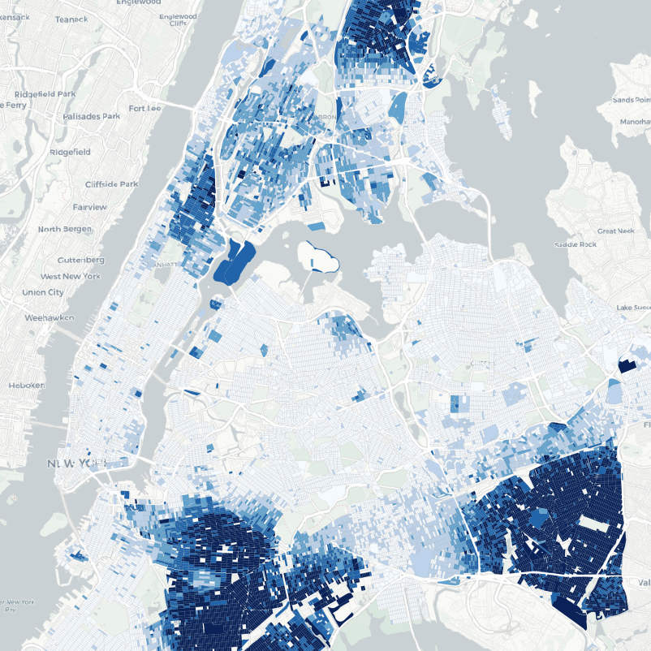
Section 13 - Spatial Joins
What is the population and racial make-up of the neighborhoods of Manhattan?
Notes:
The combination of a JOIN with a GROUP BY provides the kind of analysis that is usually done in a GIS system.
Here we have a question that combines information from about population from the census
with the boundaries of neighborhoods, with a restriction to just one borough of Manhattan.

Slide 137
Section 13 - Spatial Joins
SELECT n.name AS neighborhood_name,
SUM(c.popn_total) AS population,
100*SUM(c.popn_white)/SUM(c.popn_total) AS white_pct,
100*SUM(c.popn_black)/SUM(c.popn_total) AS black_pct
FROM nyc_neighborhoods AS n
JOIN nyc_census_blocks AS c
ON ST_Intersects(
n.geom,
c.geom
)
WHERE n.boroname = 'Manhattan'
GROUP BY n.name
ORDER BY white_pct DESC;

Slide 138
Section 13 - Spatial Joins
neighborhood_name | popn | white % | black %
---------------------+--------+---------+---------
Carnegie Hill | 18763 | 90.1 | 1.4
West Village | 26718 | 87.6 | 2.2
North Sutton Area | 22460 | 87.6 | 1.6
Upper East Side | 203741 | 85.0 | 2.7
Soho | 15436 | 84.6 | 2.2
Greenwich Village | 57224 | 82.0 | 2.4
Central Park | 46600 | 79.5 | 8.0
Tribeca | 20908 | 79.1 | 3.5
Gramercy | 104876 | 75.5 | 4.7
Murray Hill | 29655 | 75.0 | 2.5
Chelsea | 61340 | 74.8 | 6.4
Upper West Side | 214761 | 74.6 | 9.2
Midtown | 76840 | 72.6 | 5.2
Battery Park | 17153 | 71.8 | 3.4
neighborhood_name | popn | white % | black %
---------------------+--------+---------+---------
Financial District | 34807 | 69.9 | 3.8
Clinton | 32201 | 65.3 | 7.9
East Village | 82266 | 63.3 | 8.8
Garment District | 10539 | 55.2 | 7.1
Morningside Heights | 42844 | 52.7 | 19.4
Little Italy | 12568 | 49.0 | 1.8
Yorkville | 58450 | 35.6 | 29.7
Inwood | 50047 | 35.2 | 16.8
Washington Heights | 169013 | 34.9 | 16.8
Lower East Side | 96156 | 33.5 | 9.1
East Harlem | 60576 | 26.4 | 40.4
Hamilton Heights | 67432 | 23.9 | 35.8
Chinatown | 16209 | 15.2 | 3.8
Harlem | 134955 | 15.1 | 67.1

Slide 139
Section 13 - Spatial Joins
Let's explore the racial geography of New York City...
Notes:
...using distance queries

Slide 140
Overall Racial Make-up of NYC
Section 13 - Spatial Joins
SELECT
100.0*SUM(popn_white)/SUM(popn_total) AS white_pct,
100.0*SUM(popn_black)/SUM(popn_total) AS black_pct,
SUM(popn_total) AS popn_total
FROM nyc_census_blocks;
white_pct | black_pct | popn_total
-------------------+--------------------+------------
44.00395007628105 | 25.546578900241613 | 8175032
Notes:
Of the ~8M people in NYC, 44% are white and 26% are black.

Slide 141


Section 13 - Spatial Joins
You, must take the train.
To, go to Sugar Hill way up in Harlem.
Notes:
"Take the 'A' Train" - https://www.youtube.com/watch?v=cb2w2m1JmCY
As we saw earlier, Harlem has far and away the highest African-American population in Manhattan.
Is the same true of Duke’s A-train?

Slide 142
Section 13 - Spatial Joins
What is the racial make-up of the areas served by the train?

Slide 143
Section 13 - Spatial Joins
First, we must determine where the train stops.
Notes:
nyc_subway_stations table
routes field

Slide 144
Our routes are comma-separated strings!
Section 13 - Spatial Joins
SELECT DISTINCT routes
FROM nyc_subway_stations;
4,5
N,Q,R,W
J
B,M,Q,R
D,F,N,Q
J,M
E,F
...
Notes:
The values in there are a little complex.
NOTE: The DISTINCT keyword eliminates duplicate rows from the result.
Without the DISTINCT keyword, the query above identifies 491 results instead of 73.
(Note: there are nulls in the result set)

Slide 145
Postgres string function: strpos()
Section 13 - Spatial Joins
strpos(routes,'A') returns a non-zero number if 'A' is in the routes field
Check out https://www.postgresql.org/docs/current/functions-string.html
Notes:
We will want any row in routes that has an ‘A’ in it.
Can do this a number of ways**
strpos(routes,’A’) returns a non-zero number if ‘A’ is in the routes field.

Slide 146
Find all routes with an “A”
Section 13 - Spatial Joins
SELECT DISTINCT routes
FROM nyc_subway_stations AS subways
WHERE strpos(subways.routes,'A') > 0;
A,C
A,B,C,D
A,C,E,L
A,C,F
A,B,C
A,S
A,C,E
...
Notes:
The values in there are a little complex.
NOTE: The DISTINCT keyword eliminates duplicate rows from the result.
Without the DISTINCT keyword, the query above identifies 491 results instead of 73.
(Note: there are nulls in the result set)

Slide 147
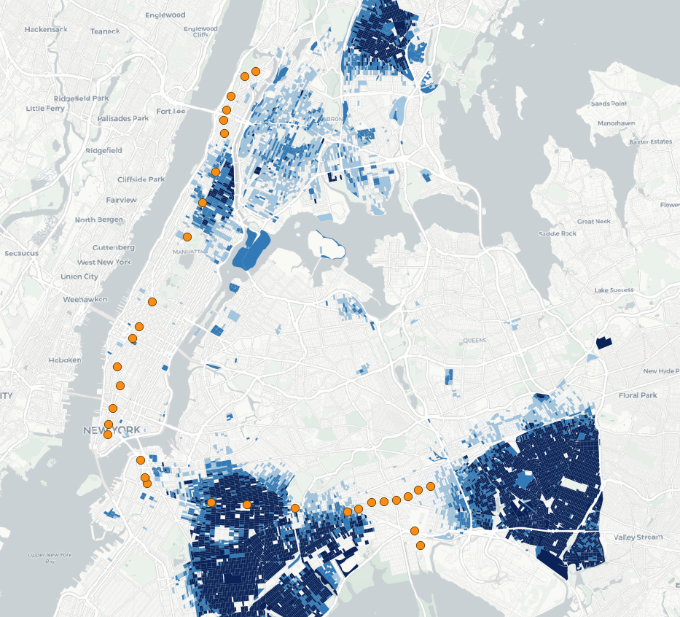
Section 13 - Spatial Joins
The route of the A train.
What is the racial makeup within 200 meters of each stop? Who is served by the A train?
Notes:
So finally. . back to the question:
What is the racial make-up of the areas served by the A train?

Slide 148
Summarize population 200m from A train stops
Section 13 - Spatial Joins
SELECT
100*SUM(c.popn_white)/SUM(c.popn_total) AS white_pct,
100*SUM(c.popn_black)/SUM(c.popn_total) AS black_pct,
SUM(popn_total) AS popn_total
FROM nyc_census_blocks AS c
JOIN nyc_subway_stations AS s
ON ST_DWithin(
c.geom,
s.geom,
200
)
WHERE strpos(s.routes,'A') > 0;

Slide 149
Section 13 - Spatial Joins
New York | Train
44.00% white | 45.59% white
25.55% black | 22.09% black
Notes:
The racial make-up along the A-train isn’t radically different from the make-up of New York City as a whole.
Recall of the 8M people in New York, about 44% are “white” and 26% are “black”.

Slide 150
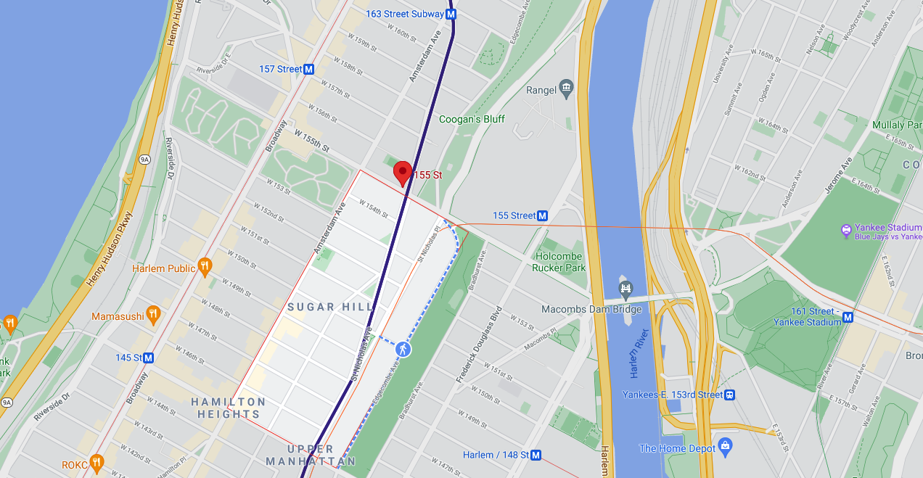
Section 13 - Spatial Joins
You, must take the train.
To, go to Sugar Hill way up in Harlem.

Slide 151

Section 14 - Spatial Joins Exercises
Section 14 - Spatial Joins Exercises

Slide 152
What subway station is in ‘Little Italy’? What subway route is it on?
Section 14 - Spatial Joins Exercises
SELECT s.name, s.routes
FROM nyc_subway_stations AS s
JOIN nyc_neighborhoods AS n
ON ST_Contains(n.geom, s.geom)
WHERE n.name = 'Little Italy';
Spring St | 6

Slide 153
What are all the neighborhoods served by the 6 train?
Section 14 - Spatial Joins Exercises
SELECT DISTINCT n.name, n.boroname
FROM nyc_subway_stations AS s
JOIN nyc_neighborhoods AS n
ON ST_Contains(n.geom, s.geom)
WHERE strpos(s.routes,'6') > 0;
Midtown
Hunts Point
…

Slide 154
After 9/11, the ‘Battery Park’ neighborhood was off limits for several days. How many people had to be evacuated?
Section 14 - Spatial Joins Exercises
SELECT Sum(popn_total)
FROM nyc_neighborhoods AS n
JOIN nyc_census_blocks AS c
ON ST_Intersects(n.geom, c.geom)
WHERE n.name = 'Battery Park';
17153

Slide 155
What neighborhood has the highest population density (persons/km2)?
Section 14 - Spatial Joins Exercises
SELECT n.name,
1000000 * Sum(c.popn_total) / ST_Area(n.geom) AS popn_per_sqkm
FROM nyc_census_blocks AS c
JOIN nyc_neighborhoods AS n
ON ST_Intersects(c.geom, n.geom)
GROUP BY n.name, n.geom
ORDER BY popn_per_sqkm DESC; North Sutton Area | 68435.13283772678

Slide 156
Section 15 - Spatial Indexing
Section 15 - Spatial Indexing

Slide 157
A spatial database has...
Section 15 - Spatial Indexing
Spatial Data Types
geometry, geography
Spatial Indexes
r-tree, quad-tree, kd-tree
Spatial Functions
ST_Length(geometry), ST_X(geometry)

Slide 158
A spatial index speeds spatial query ...
Section 15 - Spatial Indexing
Join two tables of 10,000 records each
Without Index | With Index
10,000 * 10,000 = 100,000,000 comparisons | 10,000 + 10,000 = 20,000 comparisons

Slide 159
To prove it… remove the index.
Run a spatial join.
Section 15 - Spatial Indexing
DROP INDEX nyc_census_blocks_geom_idx;
SELECT b.blkid
FROM nyc_census_blocks b
JOIN nyc_subway_stations s
ON ST_Contains(b.geom, s.geom)
WHERE s.name LIKE 'B%';
~300 ms

Slide 160
Create the index again.
Run the join again.
Section 15 - Spatial Indexing
CREATE INDEX nyc_census_blocks_geom_idx ON nyc_census_blocks USING GIST (geom);
SELECT blocks.blkid
FROM nyc_census_blocks b
JOIN nyc_subway_stations s
ON ST_Contains(b.geom, s.geom)
WHERE s.name LIKE 'B%';
~90 ms

Slide 161

Spatial Index Cliff Notes
Section 15 - Spatial Indexing
CREATE INDEX index_name ON table_name USING GIST (geom)
Use a “spatially indexed function” in JOIN or WHERE clause
ST_Intersects(A, B), ST_Contains(A, B), ST_Within(A, B)
ST_DWithin(A, B, R)

Slide 162

Spatial Index Internals
Section 15 - Spatial Indexing
Some spatial objects (like the star) are quite large and complex. Comparing complex objects is expensive!
Instead of indexing objects directly, spatial indexes work on the bounding boxes of the objects.
The boxes are of uniform size, and can be compared to determine spatial relationships very quickly.

Slide 163
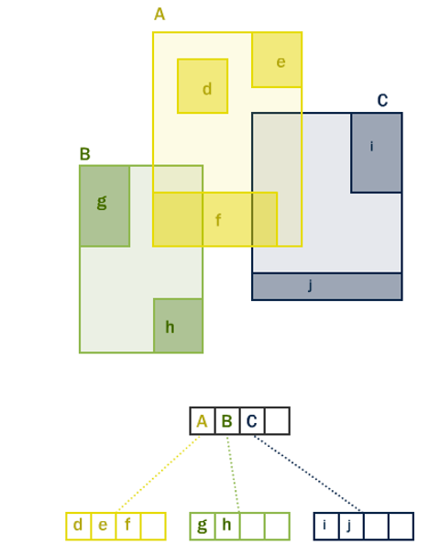
Section 15 - Spatial Indexing
The boxes can be arranged in a hierarchy, so that a query can quickly discard portions of the search space that will not interact with a query box. Depending on the algorithm, different hierarchies can be build. PostGIS uses an “R*tree” algorithm.

Slide 164
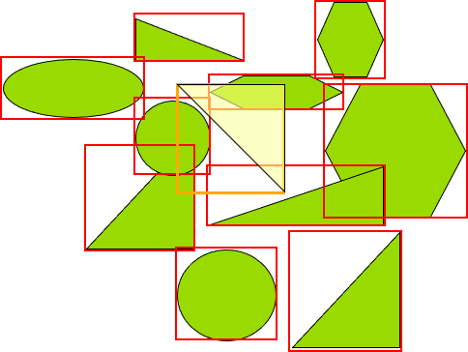
What green objects intersect the yellow query shape?
Section 15 - Spatial Indexing

Slide 165

Use index to quickly finds the objects with bounding box intersection.
Section 15 - Spatial Indexing

Slide 166

Exactly compute relationships in index result to find true intersection.
Section 15 - Spatial Indexing

Slide 167
Index-only queries
Section 15 - Spatial Indexing

Slide 168
Index-enabled Spatial Functions
Section 15 - Spatial Indexing
ST_Intersects()
ST_Contains()
ST_Within()
ST_DWithin()
ST_ContainsProperly()
ST_CoveredBy()
ST_Covers()
ST_Overlaps()
ST_Crosses()
ST_DFullyWithin()
ST_3DIntersects()
ST_3DDWithin()
ST_3DDFullyWithin()
ST_LineCrossingDirection()
ST_OrderingEquals()
ST_Equals()

Slide 169
Index-only queries
Section 15 - Spatial Indexing
geom_a && geom_b
The “&&” operator is the “bounding boxes overlap” operator.
It returns “true” when the bounds of the left and right arguments overlap.
Operators like “=” or “>” are symbols that express relationships between the left- and right-hand side arguments. “&&” is just another operator like any other.

Slide 170
What is the population of the West Village?
Section 15 - Spatial Indexing
SELECT Sum(blk.opn_total)
FROM nyc_neighborhoods nh
JOIN nyc_census_blocks blk
ON nh.geom && blk.geom
WHERE nh.name = 'West Village';
49821

Slide 171
What is the population of the West Village?
Section 15 - Spatial Indexing
SELECT Sum(blk.opn_total)
FROM nyc_neighborhoods nh
JOIN nyc_census_blocks blk
ON ST_Intersects(nh.geom, blk.geom)
WHERE nh.name = 'West Village';
26718

Slide 172
Spatial Indexes
Section 15 - Spatial Indexing
VACUUM ANALYZE nyc_census_blocks;
The database planner can only know when to use indexes if the tables have been “analyzed”.
The database executor will run more efficiently if dead tuple bloat has been removed with “vacuum”. Most important on tables with bulk data changes (insert/update/delete).

Slide 173
Section 16 - Projecting Data
Section 16 - Projecting Data

Slide 174
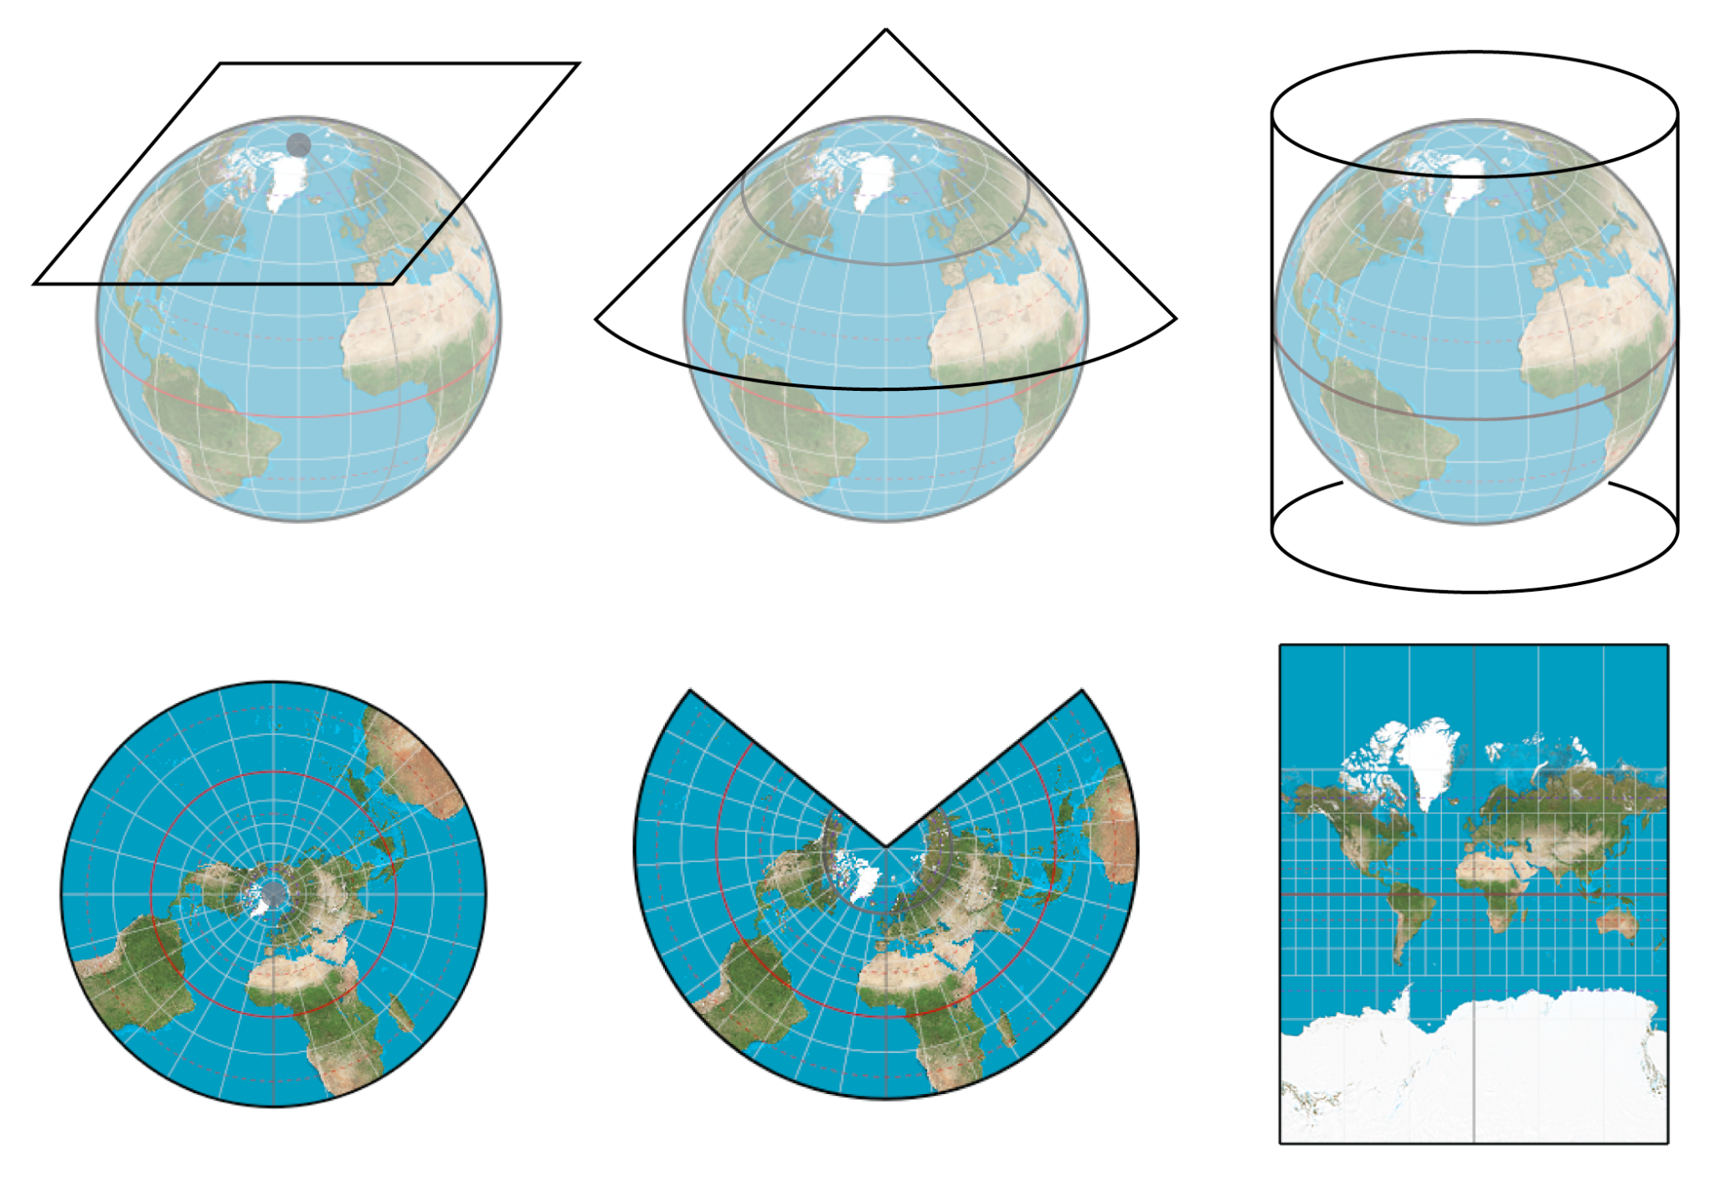
Section 16 - Projecting Data
The earth is not flat, and there is no simple way of putting it down on a flat paper map (or computer screen), so people have come up with all sorts of ingenious solutions, each with pros and cons.

Slide 175
Section 16 - Projecting Data
f(θ,Φ) → (x,y)
f ⁻¹(x,y) → (θ,Φ)
Forward projection converts spherical coordinates (longitude, latitude) to cartesian coordinates (x and y)
Inverse projection converts cartesian coordinates (x, y) to spherical coordinates (longitude, latitude)

Slide 176

Section 16 - Projecting Data

Slide 177
What is the SRID of our subways?
Section 16 - Projecting Data
SELECT ST_SRID(geom)
FROM nyc_subway_stations LIMIT 1;
26918

Slide 178
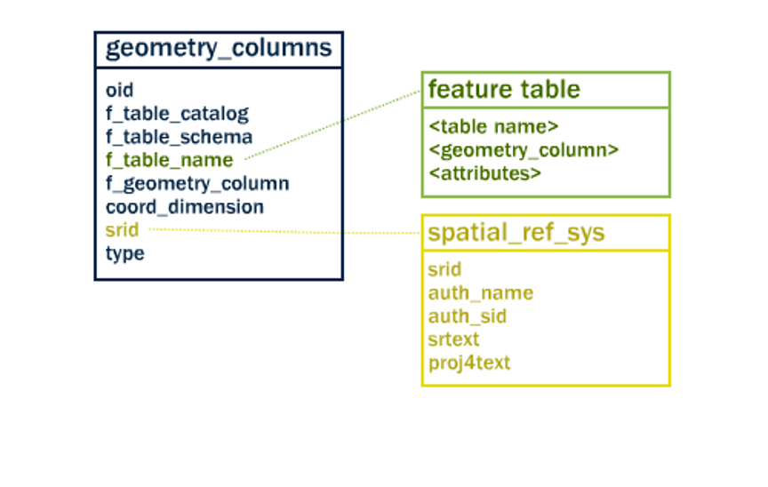
What does SRID 26918 mean though?
Section 16 - Projecting Data
SRID is a foreign key relating to spatial_ref_sys

Slide 179
What does SRID 26918 mean though?
Also, see: https://epsg.io/26918
Section 16 - Projecting Data
SELECT srtext
FROM spatial_ref_sys WHERE srid = 26918;

Slide 180
What does SRID 26918 mean though?
Section 16 - Projecting Data
PROJCS["NAD83 / UTM zone 18N",
GEOGCS["NAD83",
DATUM["North_American_Datum_1983",
SPHEROID["GRS 1980",6378137,298.257222101],
TOWGS84[0,0,0,0,0,0,0],
AUTHORITY["EPSG","6269"]],
PRIMEM["Greenwich",0],
UNIT["degree",0.0174532925199433],
AUTHORITY["EPSG","4269"]],
PROJECTION["Transverse_Mercator"],
PARAMETER["latitude_of_origin",0],
PARAMETER["central_meridian",-75],
PARAMETER["scale_factor",0.9996],
PARAMETER["false_easting",500000],
PARAMETER["false_northing",0],
UNIT["metre",1],
AXIS["Easting",EAST], AXIS["Northing",NORTH]]

Slide 181
What are coordinates of the “Broad St” subway station in geographic?
Section 16 - Projecting Data
SELECT
ST_AsText(ST_Transform(geom,4326))
FROM nyc_subway_stations
WHERE name = 'Broad St'; POINT(-74.0106714 40.7071048)

Slide 182

Section 17 - Projection Exercises
Section 17 - Projection Exercises

Slide 183
What is the length of all streets in New York, as measured in UTM 18?
Section 17 - Projection Exercises
SELECT Sum(ST_Length(geom))
FROM nyc_streets; 10418904.7172

Slide 184
What is the WKT definition of SRID 2831?
Section 17 - Projection Exercises
SELECT srtext
FROM spatial_ref_sys
WHERE SRID = 2831;
PROJCS["NAD83(HARN) / New York Long Island", ...

Slide 185
What is the length of all streets in New York, as measured in SRID 2831 (Stateplane Long Island)?
Section 17 - Projection Exercises
SELECT Sum(ST_Length( ST_Transform(geom, 2831) ))
FROM nyc_streets;
10421993.706374

Slide 186
How many streets cross the 74th meridian?
Section 17 - Projection Exercises
SELECT Count(*)
FROM nyc_streets
WHERE ST_Intersects(
ST_Transform(geom, 4326),
'SRID=4326;LINESTRING(-74 20, -74 60)'
);
223

Slide 187
Section 18 - Geography
Section 18 - Geography

Slide 188
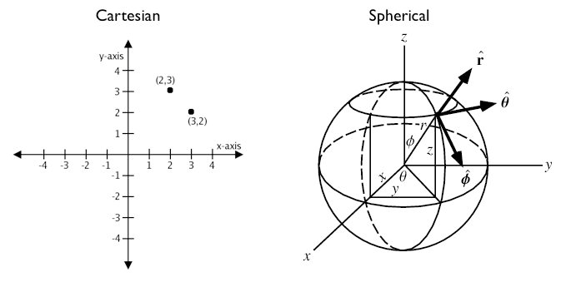
Geographic Coordinate Systems
Section 18 - Geography

Slide 189
What is the distance between Los Angeles and Paris using ST_Distance(geometry, geometry)?
Section 18 - Geography
SELECT ST_Distance( -- Los Angeles (LAX)
'SRID=4326;POINT(-118.4079 33.9434)'::geometry, -- Paris (CDG)
'SRID=4326;POINT(2.5559 49.0083)'::geometry
);
121.898285970107

Slide 190
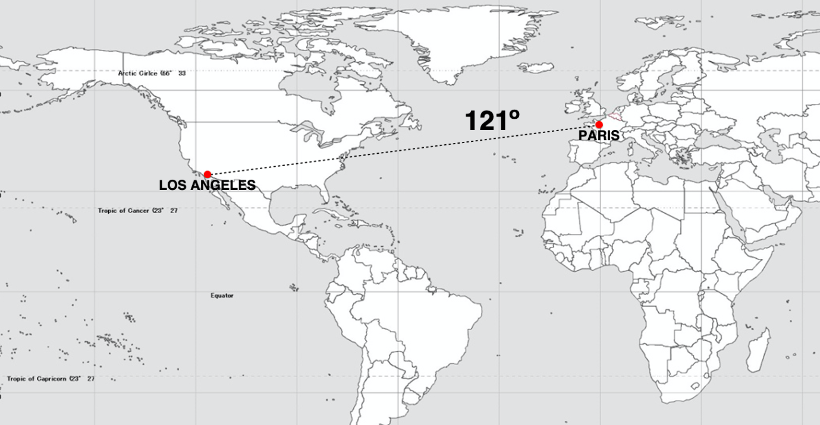
Section 18 - Geography

Slide 191
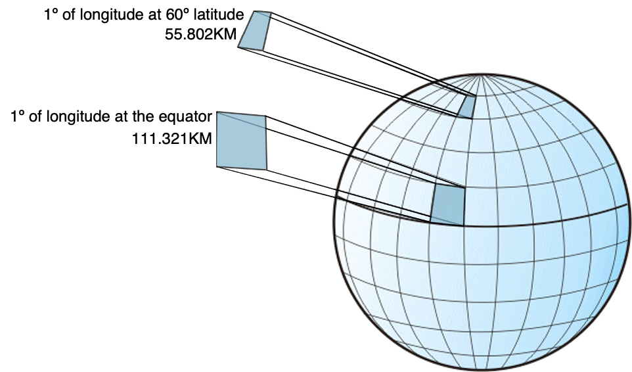
Degrees are not units of distance
Degrees are not units of area
Section 18 - Geography

Slide 192
What is the distance between Los Angeles and Paris using ST_Distance(geography, geography)?
Section 18 - Geography
SELECT ST_Distance( -- Los Angeles (LAX)
'SRID=4326;POINT(-118.4079 33.9434)'::geography, -- Paris (CDG)
'SRID=4326;POINT(2.5559 49.0083)'::geography
);
9124665.27317673

Slide 193
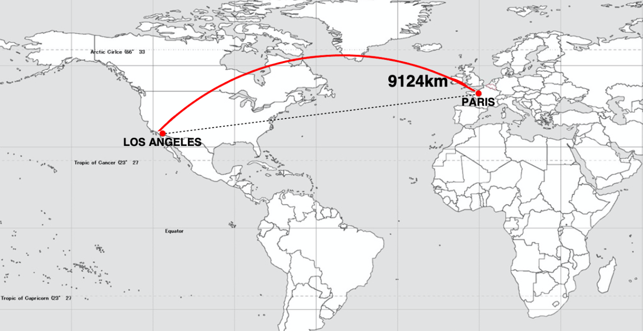
Section 18 - Geography

Slide 194
How close will a flight from Los Angeles to Paris come to Iceland?
Section 18 - Geography
SELECT ST_Distance(
-- LAX-CDG
'SRID=4326;LINESTRING( -118.4079 33.9434, 2.5559 49.0083)'::geography,
-- Iceland
'SRID=4326;POINT(-21.8628 64.1286)'::geography
);
531773.75711106

Slide 195

Section 18 - Geography

Slide 196
What is the shortest great-circle route from Los Angeles to Tokyo?
Section 18 - Geography
SELECT ST_Distance(
'SRID=4326;POINT(-118.408 33.943)'::geometry, -- LAX
'SRID=4326;POINT( 139.733 35.567)'::geometry) -- NRT
AS geometry_distance,
ST_Distance(
'POINT(-118.408 33.943)'::geography, -- LAX
'POINT( 139.733 35.567)'::geography) -- NRT
AS geography_distance;
geometry_distance: 258.14610835 geography_distance: 8833973.30246194

Slide 197

Geometry Distance
Section 18 - Geography

Slide 198

Geographic Distance
Section 18 - Geography

Slide 199
Using Geography - Casting
Section 18 - Geography
CREATE TABLE nyc_subway_stations_geog AS
SELECT
ST_Transform(geom, 4326)::geography AS geog,
name,
routes
FROM nyc_subway_stations;

Slide 200
Using Geography - Indexing
Section 18 - Geography
CREATE INDEX nyc_subway_stations_geog_gix
ON nyc_subway_stations_geog
USING GIST (geog);

Slide 201
Using Geography - Querying
Section 18 - Geography
WITH empire_state_building AS ( SELECT 'POINT(-73.98501 40.74812)'::geography AS geog
) SELECT name,
ST_Distance(esb.geog, ss.geog) AS distance,
degrees(ST_Azimuth(esb.geog, ss.geog)) AS direction
FROM nyc_subway_stations_geog ss,
empire_state_building esb
WHERE ST_DWithin(ss.geog, esb.geog, 500);

Slide 202

Section 18 - Geography
287m / 299°
328m / 125°
443m / 224°

Slide 203
Using Geography - From Scratch
Section 18 - Geography
CREATE TABLE airports (
code VARCHAR(3),
geog GEOGRAPHY(Point)
);
INSERT INTO airports VALUES ('LAX', 'POINT(-118.4079 33.9434)');
INSERT INTO airports VALUES ('CDG', 'POINT(2.5559 49.0083)');
INSERT INTO airports VALUES ('KEF', 'POINT(-22.6056 63.9850)');

Slide 204
Using Geography - From Scratch
Section 18 - Geography
SELECT * FROM geography_columns;
f_table_name | f_geography_column | srid | type
nyc_subway_stations_geog | geog | 0 | Geometry
airports | geog | 4326 | Point

Slide 205
Casting to Geometry
Section 18 - Geography
SELECT
code,
ST_X(geog::geometry) AS longitude
FROM airports;
The “::” syntax tells PostgreSQL to attempt to coerce the data into the new data type, if there is an available path.

Slide 206
Geography Native Functions
Section 18 - Geography
ST_Distance(G1, G2)
ST_DWithin(G1, G2, R)
ST_Area(geog)
ST_Length(geography)
ST_Covers(G1, G2)
ST_CoveredBy(G1, G2)
ST_Intersects(G1, G2)
ST_AsText(G1)
ST_AsBinary(G1)
ST_AsSVG(G1)
ST_AsGML(G1)
ST_AsKML(G1)
ST_AsGeoJson(G1)
ST_Buffer(G1, R)
ST_Intersection(G1, G2)

Slide 207

Geography is the Magic Solution?
Section 18 - Geography
The complexity of dealing with planar projections (choosing one, getting used to it) drives some users to fixate on the geography type as a simple cure-all.
However:
Not all functions in geography have native on-the-sphere implementations yet.
The computational cost of geography compared to geometry is quite high.

Slide 208
Section 18 - Geography
geography distance
geometry distance
double R = 6371000; /* meters */
double d_lat = lat2-lat1; /* radians */
double d_lon = lon2-lon1; /* radians */
double sin_lat = sin(d_lat/2);
double sin_lon = sin(d_lon/2);
double a = sin_lat * sin_lat +
cos(lat1) * cos(lat2) *
sin_lon * sin_lon;
double c = 2 * atan2(sqrt(a),
sqrt(1-a));
double d = R * c;
double dx = x2 - x1;
double dy = y2 - y1;
double d2 = dx * dx + dy * dy;
double d = sqrt(d2);
Notes:
Doing things on the sphere has a real computational cost. Point-to-point distance functions will be run millions of times when doing a spatial join between a couple medium sized spatial tables.
As you can imagine, the routine with one square root is faster than the one with two square roots and five trig functions.
Planar coordinates are what GIS systems used, and they are what the geometry type uses, and the geometry type was the first PostGIS type.
So there are hundreds of native geometry functions, and only a handful of native geography functions.
Long story short: if your data can be modelled on a plane, if it’s not truly global, you should use the geometry type and a planar projection, don’t use geography unless you have global data!

Slide 209
Section 19 - Geography Exercises
Section 19 - Geography Exercises

Slide 210
How far is New York from Seattle? What are the units of the answer?
Section 19 - Geography Exercises
SELECT ST_Distance(
'POINT(-74.0064 40.7142)'::geography, 'POINT(-122.3331 47.6097)'::geography ); 3875538.57141352

Slide 211
What is the total length of all streets in New York, calculated on the spheroid?
Section 19 - Geography Exercises
SELECT Sum(
ST_Length(ST_Transform(geom, 4326)::geography) ) FROM nyc_streets; 10421999.666

Slide 212
What is the total length of all streets in New York, calculated on the plane?
Section 19 - Geography Exercises
SELECT Sum(
geom ) FROM nyc_streets; 10418904.717

Slide 213
How good are projections?
Section 19 - Geography Exercises
Projection | Total Length | Difference
Geography | 10421999.666032 | 0 / 0%
Long Island State Plane | 10421993.706374 | -5.9m / 0.00006%
UTM Zone 18 | 10418904.717199 | -3095m / 0.03%

Slide 214
Does ‘POINT(1 2.0001)’ intersect with ‘POLYGON((0 0, 0 2, 2 2, 2 0, 0 0))’ in geography? In geometry? Why the difference?
Section 19 - Geography Exercises
SELECT ST_Intersects(
'POINT(1 2.0001)'::geography,
'POLYGON((0 0,0 2,2 2,2 0,0 0))'::geography )
SELECT ST_Intersects(
'POINT(1 2.0001)'::geometry,
'POLYGON((0 0,0 2,2 2,2 0,0 0))'::geometry )

Slide 215

Does ‘POINT(1 2.0001)’ intersect with ‘POLYGON((0 0, 0 2, 2 2, 2 0, 0 0))’ in geography? In geometry? Why the difference?
Section 19 - Geography Exercises
straight line
great circle
geometry
geography

Slide 216
Section 20 - Geometry Constructing Functions
Section 20 - Geometry Constructing Functions

Slide 217
Functions so far...
Section 20 - Geometry Constructing Functions
Analysis
ST_Length(geometry) → float
ST_Area(geometry) → float
Conversion
ST_AsText(geometry) → text
ST_AsGML(geometry) → text
Retrieval
ST_RingN(geometry,n) → geometry
Comparison
ST_Contains(geometry,geometry) → boolean

Slide 218
Geometry constructing functions!
Section 20 - Geometry Constructing Functions
ST_Buffer(geometry) → geometry
ST_Centroid(geometry) → geometry
ST_Intersection(geometry, geometry) → geometry
ST_Union(geometry[]) → geometry
ST_Collect(geometry[]) → geometry

Slide 219

ST_Centroid
ST_PointOnSurface
Section 20 - Geometry Constructing Functions

Slide 220

ST_Buffer
Section 20 - Geometry Constructing Functions

Slide 221

“What would a 500 meter marine traffic zone around Liberty Island look like?”
Section 20 - Geometry Constructing Functions

Slide 222
“What would a 500 meter marine traffic zone around Liberty Island look like?”
Section 20 - Geometry Constructing Functions
-- New table with a Liberty Island
-- 500m buffer zone
CREATE TABLE liberty_island_zone AS
SELECT
ST_Buffer(geom, 500)::Geometry(Polygon,26918) AS geom
FROM nyc_census_blocks
WHERE blkid = '360610001001001';

Slide 223

“What would a negative 50 meter marine traffic zone around Liberty Island look like?”
Section 20 - Geometry Constructing Functions

Slide 224

ST_Intersection(A, B)
Section 20 - Geometry Constructing Functions

Slide 225
“What is the area these two circles have in common?”
Section 20 - Geometry Constructing Functions
SELECT ST_AsText(ST_Intersection(
ST_Buffer('POINT(0 0)', 2),
ST_Buffer('POINT(3 0)', 2)
));

Slide 226
“What is the area these two circles have in common?”
Section 20 - Geometry Constructing Functions
POLYGON((
2 0,
1.96157056080646 -0.390180644032256,
1.84775906502257 -0.765366864730179,
1.66293922460509 -1.1111404660392,
1.5 -1.30968248567708,
1.33706077539491 -1.11114046603921,
1.15224093497743 -0.765366864730185,
1.03842943919354 -0.390180644032262,
1 -6.46217829773035e-15,
1.03842943919354 0.39018064403225,
1.15224093497742 0.765366864730173,
1.33706077539491 1.1111404660392,
1.5 1.30968248567708,
1.66293922460509 1.11114046603921,
1.84775906502257 0.765366864730184,
1.96157056080646 0.390180644032261,
2 0))

Slide 227

ST_Union(A, B)
Section 20 - Geometry Constructing Functions

Slide 228
Terminology
Forms
Section 20 - Geometry Constructing Functions
Esri “dissolve” == PostGIS “union”
Melt together small things into larger things.
Esri “union” == PostGIS “overlay”
Cookie cut larger things into smaller things.
ST_Union(geom1, geom2)
Melt together two geometries.
ST_Union(geometry[])
Melt together a set of geometries. “Aggregate” function like Sum() or Average(). Use with GROUP BY.

Slide 229


“How would you make a county map from census blocks?”
Section 20 - Geometry Constructing Functions

Slide 230
Census Block ID
Section 20 - Geometry Constructing Functions
US Census Block IDs encode the geographic hierarchy used by the census.
360610001001001 = 36 061 000100 1 001
36 = State of New York
061 = New York County (Manhattan)
000100 = Census Tract
1 = Census Block Group
001 = Census Block
Notes:
The unique key blkid actually embeds information about the higher level geographies.
Here are the parts of the key for Liberty Island we used earlier:

Slide 231
“How would you make a county map from
census blocks?”
Section 20 - Geometry Constructing Functions
-- An nyc_census_counties table -- by merging census blocks
CREATE TABLE nyc_census_counties AS
SELECT
ST_Union(geom) AS geom,
SubStr(blkid,1,5) AS countyid
FROM nyc_census_blocks
GROUP BY countyid;

Slide 232
Section 21 - Geometry Constructing Exercises
Section 21 - Geometry Constructing Exercises

Slide 233
How many census blocks don’t contain their own centroid?
Section 21 - Geometry Constructing Exercises
SELECT Count(*)
FROM nyc_census_blocks
WHERE NOT
ST_Contains(
geom,
ST_Centroid(geom)
); 481

Slide 234
Union all the census blocks into a single output. What kind of geometry is it? How many parts does it have?
Section 21 - Geometry Constructing Exercises
CREATE TABLE nyc_census_blocks_merge AS
SELECT ST_Union(geom) AS geom
FROM nyc_census_blocks;
SELECT ST_GeometryType(geom), ST_NumGeometries(geom) FROM nyc_census_blocks_merge;
Notes:
ST_MultiPolygon
63

Slide 235
“What is the area of a one unit buffer around the origin? How different is it from what you would expect? Why?”
Section 21 - Geometry Constructing Exercises
SELECT ST_Area(ST_Buffer('POINT(0 0)', 1));
3.121445152258052
SELECT pi();
3.141592653589793

Slide 236

The Brooklyn neighborhoods of Park Slope and Carroll Gardens are going to war! Construct a polygon delineating a 100 meter wide DMZ on the border between the neighborhoods. What is the area of the DMZ?
Section 21 - Geometry Constructing Exercises

Slide 237
Section 21 - Geometry Constructing Exercises
CREATE TABLE brooklyn_dmz AS
SELECT
ST_Intersection(
ST_Buffer(ps.geom, 50),
ST_Buffer(cg.geom, 50))
AS geom
FROM
nyc_neighborhoods ps,
nyc_neighborhoods cg
WHERE ps.name = 'Park Slope'
AND cg.name = 'Carroll Gardens';
Wrap in ST_Area(...) for area
Wrap in ST_Transform(..., 4326) to see base map in PgAdmin map

Slide 238

Section 21 - Geometry Constructing Exercises

Slide 239
Section 22 - More Spatial Joins!
Section 22 - More Spatial Joins

Slide 240
Load the nyc_census_sociodata.sql table
Section 22 - More Spatial Joins
Open the Query Tool in pgAdmin
Select Open File
Browse to the nyc_census_sociodata.sql file
Run query
-- 2167 SELECT
Count(*)
FROM nyc_census_sociodata;
Notes:
*double check pgAdmin 4

Slide 241
Section 22 - More Spatial Joins
How would you make a census tract map from census blocks?
Notes:
(define tract)
Census geography is carefully constructed so that larger geographies can be built up from smaller ones.
Create a census tracts map by merging the blocks that form each tract
Create a county map by merging blocks that fall within each county.

Slide 242
Recall...
Section 22 - More Spatial Joins
Liberty Island blkid
360610001001001 = 36 061 000100 1 001
36 = State of New York
061 = New York County (Manhattan)
000100 = Census Tract
1 = Census Block Group
001 = Census Block
Notes:
The unique key blkid actually embeds information about the higher level geographies.
Here are the parts of the key for Liberty Island we used earlier:

Slide 243


Section 22 - More Spatial Joins
Blocks
Tracts

Slide 244
ST_Union() Blocks into Tracts
Section 22 - More Spatial Joins
-- Make the tracts table
CREATE TABLE nyc_census_tract_geoms AS
SELECT
ST_Union(geom) AS geom,
substr(blkid,1,11) AS tractid
FROM nyc_census_blocks
GROUP BY tractid;
-- Index the tractid
CREATE INDEX nyc_census_tract_geoms_tractid_idx
ON nyc_census_tract_geoms (tractid);

Slide 245
Section 22 - More Spatial Joins
How can you associate census data with your census tract map?

Slide 246
ST_Union() Blocks into Tracts
Section 22 - More Spatial Joins
-- Make the tracts table
CREATE TABLE nyc_census_tracts AS
SELECT g.geom, a.*
FROM nyc_census_tract_geoms g
JOIN nyc_census_sociodata a
ON g.tractid = a.tractid;
-- Index the geometries
CREATE INDEX nyc_census_tract_gidx ON nyc_census_tracts USING GIST (geom);

Slide 247
Section 22 - More Spatial Joins
“List top 10 New York neighborhoods ordered by the proportion of people who have graduate degrees?”

Slide 248
Graduate Degree Population %
Section 22 - More Spatial Joins
SELECT
100.0 * Sum(t.edu_graduate_dipl) /
Sum(t.edu_total) AS graduate_pct,
n.name, n.boroname
FROM nyc_neighborhoods n
JOIN nyc_census_tracts t
ON ST_Intersects(n.geom, t.geom)
WHERE t.edu_total > 0
GROUP BY n.name, n.boroname
ORDER BY graduate_pct DESC
LIMIT 10;

Slide 249
Graduate Degree Population %
Section 22 - More Spatial Joins
graduate_pct | name | boroname
---------------------+-------------------+-----------
47.6469321851453175 | Carnegie Hill | Manhattan
42.1632365492235696 | Upper West Side | Manhattan
41.0656645950763598 | Battery Park | Manhattan
39.5611557679774060 | Flatbush | Brooklyn
39.3409549428379287 | Tribeca | Manhattan
39.2188240872451399 | North Sutton Area | Manhattan
38.6922550118291620 | Greenwich Village | Manhattan
38.6054942073575506 | Upper East Side | Manhattan
37.8834795573140662 | Murray Hill | Manhattan
37.3714416181491744 | Central Park | Manhattan

Slide 250


Slide 251

The otherwise-empty “Flatbush” neighborhood polygon (which mostly covers Prospect Park) just grazes one high-education tract polygon, resulting in a spurious high measurement for the neighborhood.

Slide 252
Section 22 - More Spatial Joins
What if a tract falls on the border between two neighborhoods?
Notes:
(remember to define tract)
It will intersect both, and so will be included in the summary statistics for both.

Slide 253

Centroid as proxy for polygons
Section 22 - More Spatial Joins
Notes:
It will intersect both, and so will be included in the summary statistics for both.
Avoid this kind of double counting:
The simple method is to ensure that each tract only falls in one summary area (using ST_Centroid(geometry))
The complex method is to divide crossing tracts at the borders (using ST_Intersection(geometry,geometry))

Slide 254
Join on ST_Centroid
Section 22 - More Spatial Joins
SELECT
100.0 * Sum(t.edu_graduate_dipl) / Sum(t.edu_total) AS graduate_pct,
n.name,
n.boroname
FROM nyc_neighborhoods n
JOIN nyc_census_tracts t
ON ST_Contains(n.geom, ST_Centroid(t.geom))
WHERE t.edu_total > 0
GROUP BY n.name, n.boroname
ORDER BY graduate_pct DESC
LIMIT 10;
Notes:
Note that the query takes longer to run now, because the ST_Centroid function has to be run on every census tract.

Slide 255
Join on intersects vs centroid
ST_Intersects()
ST_Centroid()
Section 22 - More Spatial Joins
graduate_pct | name | boroname
--------------+---------------------+-----------
47.6 | Carnegie Hill | Manhattan
42.2 | Upper West Side | Manhattan
41.1 | Battery Park | Manhattan
39.6 | Flatbush | Brooklyn
39.3 | Tribeca | Manhattan
39.2 | North Sutton Area | Manhattan
38.7 | Greenwich Village | Manhattan
38.6 | Upper East Side | Manhattan
37.9 | Murray Hill | Manhattan
37.4 | Central Park | Manhattan
graduate_pct | name | boroname
--------------+---------------------+-----------
48.0 | Carnegie Hill | Manhattan
44.2 | Morningside Heights | Manhattan
42.1 | Greenwich Village | Manhattan
42.0 | Upper West Side | Manhattan
41.4 | Tribeca | Manhattan
40.7 | Battery Park | Manhattan
39.5 | Upper East Side | Manhattan
39.3 | North Sutton Area | Manhattan
37.4 | Cobble Hill | Brooklyn
37.4 | Murray Hill | Manhattan
Notes:
Note that the query takes longer to run now, because the ST_Centroid function has to be run on every census tract.

Slide 256
Section 22 - More Spatial Joins
How many people live within 500m of a subway station?
Notes:
It will intersect both, and so will be included in the summary statistics for both.

Slide 257
ST_Centroid
Section 22 - More Spatial Joins
How many people in New York?
SELECT
Sum(popn_total)
FROM nyc_census_blocks;
Notes:
Note that the query takes longer to run now, because the ST_Centroid function has to be run on every census tract.

Slide 258
ST_Centroid
Section 22 - More Spatial Joins
How many people 500m from a subway station?
SELECT
Sum(popn_total)
FROM nyc_census_blocks census
JOIN nyc_subway_stations subway
ON ST_DWithin(
census.geom,
subway.geom,
500
);
Notes:
Note that the query takes longer to run now, because the ST_Centroid function has to be run on every census tract.

Slide 259
ST_Centroid
Section 22 - More Spatial Joins
How many people in New York?
8,175,032
How many people 500m from a subway station?
10,855,873 ?!?!!?
Notes:
Note that the query takes longer to run now, because the ST_Centroid function has to be run on every census tract.

Slide 260

Overlapping query areas
Section 22 - More Spatial Joins

Slide 261
Overlapping query areas
Section 22 - More Spatial Joins
How many people 500m from a subway station?
WITH distinct_blocks AS (
SELECT DISTINCT ON (blkid) popn_total
FROM nyc_census_blocks census
JOIN nyc_subway_stations subway
ON ST_DWithin(
census.geom,
subway.geom,
500)
)
SELECT Sum(popn_total)
FROM distinct_blocks;
Notes:
Note that the query takes longer to run now, because the ST_Centroid function has to be run on every census tract.

Slide 262
Section 23 - Validity
Section 23 - Validity

Slide 263

POLYGON((0 0, 0 1, 2 1, 2 2, 1 2, 1 0, 0 0))
Section 23 - Validity

Slide 264

Why does validity matter?
Section 23 - Validity
Geometry algorithms rely on properties enforced by validity: ring orientation, self-crossing, self-touching. All can confuse different algorithms.
-1
SELECT ST_Area(ST_GeomFromText(
'POLYGON((0 0, 0 1, 1 1, 2 1, 2 2, 1 2, 1 1, 1 0, 0 0))'
));
0
1

Slide 265
Can we test validity?
Section 23 - Validity
Self-intersection[1 1]
ST_IsValid() returns a boolean for validity, and ST_IsValidReason() returns a coordinate of where the error is, and a textual reason.
SELECT ST_IsValid(ST_GeomFromText(
'POLYGON((0 0, 0 1, 1 1, 2 1, 2 2, 1 2, 1 1, 1 0, 0 0))'
));
false

Slide 266
Can we test validity in bulk?
Section 23 - Validity
SELECT name, boroname,
ST_IsValidReason(geom)
FROM nyc_neighborhoods
WHERE NOT ST_IsValid(geom); Howard Beach | Queens | Self-intersection[596394 4500899]
Corona | Queens | Self-intersection[595483 4513817]
Red Hook | Brooklyn | Self-intersection[582655 4500908]
Steinway | Queens | Self-intersection[593198 4515125]

Slide 267

Can we fix validity in bulk?
Section 23 - Validity
The “banana polygon” is a polygon with a hole, formed by a ring that touches itself at a single point.
SELECT ST_AsText(ST_MakeValid( 'POLYGON((0 0, 2 0, 1 1, 2 2, 3 1, 2 0, 4 0, 4 4, 0 4, 0 0))'))
ST_MakeValid() juggles the components of an invalid polygon to form a “best guess” valid interpretation of the rings. The “banana polygon” gets turns into a traditional exterior/interior ring polygon.
POLYGON((0 0,0 4,4 4,4 0,2 0,0 0),(3 1,2 2,1 1,2 0,3 1))

Slide 268
Can we fix validity in bulk?
ST_MakeValid(geom, options)
Section 23 - Validity
UPDATE nyc_neighborhoods SET geom = ST_MakeValid(geom)
WHERE NOT ST_IsValid(geom);
PostGIS 3.2+ includes text options to change the repair algorithm.
'method=linework'
'method=structure keepcollapsed=false'

Slide 269
Section 24 - Equality
Section 24 - Equality

Slide 270

Section 24 - Equality

Slide 271
Create the test polygons
CREATE TABLE polygons (id integer, name varchar, poly geometry);
INSERT INTO polygons VALUES
(1, 'Polygon 1', 'POLYGON((-1 1.732,1 1.732,2 0,1 -1.732,
-1 -1.732,-2 0,-1 1.732))'),
(2, 'Polygon 2', 'POLYGON((-1 1.732,-2 0,-1 -1.732,1 -1.732,
2 0,1 1.732,-1 1.732))'),
(3, 'Polygon 3', 'POLYGON((1 -1.732,2 0,1 1.732,-1 1.732,
-2 0,-1 -1.732,1 -1.732))'),
(4, 'Polygon 4', 'POLYGON((-1 1.732,0 1.732, 1 1.732,1.5 0.866,
2 0,1.5 -0.866,1 -1.732,0 -1.732,-1 -1.732,-1.5 -0.866,
-2 0,-1.5 0.866,-1 1.732))'),
(5, 'Polygon 5', 'POLYGON((-2 -1.732,2 -1.732,2 1.732,
-2 1.732,-2 -1.732))');
Section 24 - Equality

Slide 272
Ways of testing equality!
Section 24 - Equality
ST_OrderingEquals(A, B)
ST_Equals(A, B)
A = B
A ~= B

Slide 273
Section 24 - Equality
SELECT a.name, b.name, CASE WHEN ST_OrderingEquals(a.poly, b.poly) THEN 'Exactly Equal' ELSE 'Not Exactly Equal' END
FROM polygons AS a, polygons AS b;
Polygon 1 | Polygon 1 | Exactly Equal
Polygon 1 | Polygon 2 | Not Exactly Equal
Polygon 1 | Polygon 3 | Not Exactly Equal
Polygon 1 | Polygon 4 | Not Exactly Equal
Polygon 1 | Polygon 5 | Not Exactly Equal
Polygon 2 | Polygon 1 | Not Exactly Equal
Polygon 2 | Polygon 2 | Exactly Equal
Polygon 2 | Polygon 3 | Not Exactly Equal
Polygon 2 | Polygon 4 | Not Exactly Equal
Polygon 2 | Polygon 5 | Not Exactly Equal
Polygon 3 | Polygon 1 | Not Exactly Equal
Polygon 3 | Polygon 2 | Not Exactly Equal
Polygon 3 | Polygon 3 | Exactly Equal
Polygon 3 | Polygon 4 | Not Exactly Equal
Polygon 3 | Polygon 5 | Not Exactly Equal
Polygon 4 | Polygon 1 | Not Exactly Equal
Polygon 4 | Polygon 2 | Not Exactly Equal
Polygon 4 | Polygon 3 | Not Exactly Equal
Polygon 4 | Polygon 4 | Exactly Equal
Polygon 4 | Polygon 5 | Not Exactly Equal
Polygon 5 | Polygon 1 | Not Exactly Equal
Polygon 5 | Polygon 2 | Not Exactly Equal
Polygon 5 | Polygon 3 | Not Exactly Equal
Polygon 5 | Polygon 4 | Not Exactly Equal
Polygon 5 | Polygon 5 | Exactly Equal

Slide 274
Section 24 - Equality
SELECT a.name, b.name, CASE WHEN ST_Equals(a.poly, b.poly) THEN 'Spatially Equal' ELSE 'Not Equal' END
FROM polygons AS a, polygons AS b;
Polygon 1 | Polygon 1 | Spatially Equal
Polygon 1 | Polygon 2 | Spatially Equal
Polygon 1 | Polygon 3 | Spatially Equal
Polygon 1 | Polygon 4 | Spatially Equal
Polygon 1 | Polygon 5 | Not Equal
Polygon 2 | Polygon 1 | Spatially Equal
Polygon 2 | Polygon 2 | Spatially Equal
Polygon 2 | Polygon 3 | Spatially Equal
Polygon 2 | Polygon 4 | Spatially Equal
Polygon 2 | Polygon 5 | Not Equal
Polygon 3 | Polygon 1 | Spatially Equal
Polygon 3 | Polygon 2 | Spatially Equal
Polygon 3 | Polygon 3 | Spatially Equal
Polygon 3 | Polygon 4 | Spatially Equal
Polygon 3 | Polygon 5 | Not Equal
Polygon 4 | Polygon 1 | Spatially Equal
Polygon 4 | Polygon 2 | Spatially Equal
Polygon 4 | Polygon 3 | Spatially Equal
Polygon 4 | Polygon 4 | Spatially Equal
Polygon 4 | Polygon 5 | Not Equal
Polygon 5 | Polygon 1 | Not Equal
Polygon 5 | Polygon 2 | Not Equal
Polygon 5 | Polygon 3 | Not Equal
Polygon 5 | Polygon 4 | Not Equal
Polygon 5 | Polygon 5 | Spatially Equal

Slide 275
Section 24 - Equality
SELECT a.name, b.name, CASE WHEN a.poly = b.poly THEN 'Spatially =' ELSE 'Not =' END
FROM polygons AS a, polygons AS b;
Polygon 1 | Polygon 1 | Spatially =
Polygon 1 | Polygon 2 | Not =
Polygon 1 | Polygon 3 | Not =
Polygon 1 | Polygon 4 | Not =
Polygon 1 | Polygon 5 | Not =
Polygon 2 | Polygon 1 | Not =
Polygon 2 | Polygon 2 | Spatially =
Polygon 2 | Polygon 3 | Not =
Polygon 2 | Polygon 4 | Not =
Polygon 2 | Polygon 5 | Not =
Polygon 3 | Polygon 1 | Not =
Polygon 3 | Polygon 2 | Not =
Polygon 3 | Polygon 3 | Spatially =
Polygon 3 | Polygon 4 | Not =
Polygon 3 | Polygon 5 | Not =
Polygon 4 | Polygon 1 | Not =
Polygon 4 | Polygon 2 | Not =
Polygon 4 | Polygon 3 | Not =
Polygon 4 | Polygon 4 | Spatially =
Polygon 4 | Polygon 5 | Not =
Polygon 5 | Polygon 1 | Not =
Polygon 5 | Polygon 2 | Not =
Polygon 5 | Polygon 3 | Not =
Polygon 5 | Polygon 4 | Not =
Polygon 5 | Polygon 5 | Spatially =

Slide 276
Section 24 - Equality
SELECT a.name, b.name, CASE WHEN a.poly ~= b.poly THEN 'Bounds Equal' ELSE 'Bounds Not Equal' END
FROM polygons AS a, polygons AS b;
Polygon 1 | Polygon 1 | Bounds Equal
Polygon 1 | Polygon 2 | Bounds Equal
Polygon 1 | Polygon 3 | Bounds Equal
Polygon 1 | Polygon 4 | Bounds Equal
Polygon 1 | Polygon 5 | Bounds Equal
Polygon 2 | Polygon 1 | Bounds Equal
Polygon 2 | Polygon 2 | Bounds Equal
Polygon 2 | Polygon 3 | Bounds Equal
Polygon 2 | Polygon 4 | Bounds Equal
Polygon 2 | Polygon 5 | Bounds Equal
Polygon 3 | Polygon 1 | Bounds Equal
Polygon 3 | Polygon 2 | Bounds Equal
Polygon 3 | Polygon 3 | Bounds Equal
Polygon 3 | Polygon 4 | Bounds Equal
Polygon 3 | Polygon 5 | Bounds Equal
Polygon 4 | Polygon 1 | Bounds Equal
Polygon 4 | Polygon 2 | Bounds Equal
Polygon 4 | Polygon 3 | Bounds Equal
Polygon 4 | Polygon 4 | Bounds Equal
Polygon 4 | Polygon 5 | Bounds Equal
Polygon 5 | Polygon 1 | Bounds Equal
Polygon 5 | Polygon 2 | Bounds Equal
Polygon 5 | Polygon 3 | Bounds Equal
Polygon 5 | Polygon 4 | Bounds Equal
Polygon 5 | Polygon 5 | Bounds Equal

Slide 277
Section 25 - Linear Referencing
Section 25 - Linear Referencing

Slide 278



Section 25 - Linear Referencing
“B is 40% of the way along A”

Slide 279
Section 25 - Linear Referencing
hyw | brdg | loc
12 | 101 | 10.5
hyw | geom
12
“The bridge is at mile 10.5 on Highway 12”

Slide 280

Section 25 - Linear Referencing
rvr | fsh | from | to
9 | 101 | 3 | 5
hyw | geom
9
“The salmon habitat is from 3km to 5km above the confluence”

Slide 281
Section 25 - Linear Referencing
SELECT ST_LineLocatePoint( 'LINESTRING(0 0,2 2)', 'POINT(0.9 1.1)' );
0.5

Slide 282
Section 25 - Linear Referencing
SELECT ST_AsText( ST_LineInterpolatePoint( 'LINESTRING(0 0,2 2)', 0.5 ));
POINT(1, 1)

Slide 283

Section 25 - Linear Referencing

Slide 284
Find nearest street to each subway station
WITH ordered_nearest AS (
SELECT
ST_GeometryN(str.geom,1) AS streets_geom,
str.gid AS str_gid,
sub.geom AS subways_geom,
sub.gid AS subways_gid,
ST_Distance(str.geom, sub.geom) AS distance
FROM nyc_streets str
JOIN nyc_subway_stations sub
ON ST_DWithin(str.geom, sub.geom, 200)
ORDER BY subways_gid, distance ASC
)
Section 25 - Linear Referencing

Slide 285
Find measure of station on nearest street
SELECT
DISTINCT ON (subways_gid)
subways_gid,
streets_gid,
distance, ST_LineLocatePoint(
streets_geom,
subways_geom) AS measure
FROM ordered_nearest;
Section 25 - Linear Referencing

Slide 286
Find measure of station on nearest street
subways_gid | streets_gid | measure
-------------+-------------+------------------------
1 | 17404 | 0.0023154983819572554
2 | 17318 | 0.6354078182846773
3 | 19086 | 0.24946227178552738
4 | 1924 | 0.11187222763997673
5 | 2067 | 0.9261874246426975
6 | 1934 | 0.33457647816803476
7 | 2024 | 0.5549461001845787
8 | 2469 | 0.2296616075093935
9 | 2024 | 0.9069811058590412
10 | 2067 | 0.6202998183141508
Section 25 - Linear Referencing

Slide 287
How to visualize events? Turn them back into points.
Section 25 - Linear Referencing
-- New view that turns events back
-- into spatial objects
CREATE OR REPLACE VIEW nyc_subway_stations_lrs AS
SELECT
events.subways_gid,
ST_LineInterpolatePoint( ST_GeometryN(streets.geom, 1),
events.measure) AS geom,
events.streets_gid
FROM nyc_subway_station_events events
JOIN nyc_streets streets
ON (streets.gid = events.streets_gid);

Slide 288

Section 25 - Linear Referencing
Original subway stations (orange stars) on Columbus Circle have been snapped over to the nearby roadways in the LRS view (blue circles)
Shows how LRS functions can be used to snap points to a network, as well as to manage actual LRS data.

Slide 289
Section 26 - Dimensionally Extended 9 Intersection Model (DE9IM)
Section 26 - DE9IM

Slide 290



Interior, Boundary and Exterior
Polygons
Linestrings
Points
Section 26 - DE9IM

Slide 291

DE9IM
Section 26 - DE9IM
The DE9IM relationship between two geometries is calculated by examining the dimensionality of each intersection in the grid. The full set of 9 intersections precisely defines the nature of the spatial relationship between the geometries.

Slide 292


DE9IM
Section 26 - DE9IM
dim(I(a) ∩ I(b) = 2
dim(B(a) ∩ B(b) = 0
Notes:
The dimensionality of the intersection of the interiors of these two polygons is an area, which has a dimension of two. The I/I cell for this relationship would get a “2”.
The dimensionality of the intersection of the boundaries of these two polygons is two points, which have a dimension of zero. The B/B cell for this relationship would get a “0”.

Slide 293
DI9EM matrix codes
Section 26 - DE9IM
0 = 0-d intersection (puntal)
1 = 1-d intersection (linear)
2 = 2-d intersection (areal)
T = some intersection of any dimension
F = no intersection
* = no preference

Slide 294


Section 26 - DE9IM
Fill in the DE9IM matrix for these two geometries, examining each interaction, and then filling in the cell.
Notes:
The dimensionality of each intersection is filled in. Note the dimensionality of the boundary/boundary cell, it is “F”. That means there is NO INTERSECTION between the boundaries, and you can see that the boundaries of the (the ends) do not in fact intersect with the boundary ring of the polygon.

Slide 295

Section 26 - DE9IM
In terms of relationships, the more complex picture on the left is the same as the simple one on the right, that we will use for SQL examples.
Notes:
The dimensionality of each intersection is filled in. Note the dimensionality of the boundary/boundary cell, it is “F”. That means there is NO INTERSECTION between the boundaries, and you can see that the boundaries of the (the ends) do not in fact intersect with the boundary ring of the polygon.

Slide 296

Calculate the DI9EM matrix for two geometries
SELECT ST_Relate(
'LINESTRING(0 0, 2 0)',
'POLYGON((1 -1, 1 1, 3 1, 3 -1, 1 -1))'
);
Section 26 - DE9IM
 | I | B | E
I | 1 | 0 | 1
B | 0 | F | 0
E | 2 | 1 | 2
101 0F0 212
1010F0212

Slide 297


What is this for?
Section 26 - DE9IM
“Legal” docks have a specific pattern: IFF00F212
Data quality control. Some features have very specific allowed relationships to other features. Find the ones that break the rules in order to flag and fix them.

Slide 298
What is this for? Find any illegal docks.
SELECT docks.*
FROM docks
JOIN lakes
ON ST_Intersects(docks.geom, lakes.geom)
WHERE NOT
ST_Relate(docks.geom,
lakes.geom,
'1FF00F212');
Section 26 - DE9IM

Slide 299

What is this for? Find overlapping census blocks!
Section 26 - DE9IM
 | I | B | E
I | 2 | * | *
B | * | * | *
E | * | * | *

Slide 300
What is this for? Find overlapping census blocks!
SELECT a.gid, b.gid
FROM nyc_census_blocks a,
nyc_census_blocks b
WHERE ST_Intersects(a.geom, b.geom)
AND ST_Relate(a.geom,
b.geom,
'2********')
AND a.gid != b.gid
LIMIT 10;
Section 26 - DE9IM
 | I | B | E
I | 2 | * | *
B | * | * | *
E | * | * | *

Slide 301

What is this for? Find non-noded streets!
Section 26 - DE9IM
 | I | B | E
I | * | * | *
B | * | T | *
E | * | * | *
Non-noded intersections could be either 0-dimensional (simple crossing) or 1-dimensional (shared interior while). Any intersection of interiors is a non-noded case, so we test for the “T” condition: any intersection at all.

Slide 302
What is this for? Find non-noded streets!
SELECT a.gid, b.gid
FROM nyc_streets a,
nyc_streets b
WHERE ST_Intersects(a.geom,
b.geom)
AND NOT ST_Relate(a.geom,
b.geom,
'****T****')
AND a.gid != b.gid
LIMIT 10;
Section 26 - DE9IM
 | I | B | E
I | * | * | *
B | * | T | *
E | * | * | *

Slide 303
Section 27 - Clustering on Indexes
Section 27 - Clustering on Indexes

Slide 304

Section 27 - Clustering on Indexes
Notes:
The normal access pattern for geospatial data is to access data that are “near” to one another in space at the same time. Search rectangles, nearest neighbors, radius searches, all pull data that are “near” to each other.

Slide 305

Section 27 - Clustering on Indexes
Notes:
Putting the data that are “near” in space “near” in terms of storage can speed up access, because modern computers tend to fetch data in larger chunks. If all the data you want are in the same chunk, the pre-fetch actions of the operating system or disks will tend to incidentally speed up your data query.

Slide 306
Cluster using Spatial Index
-- Cluster the blocks table based
-- on their spatial index
CLUSTER nyc_census_blocks
USING nyc_census_blocks_geom_gist;
Section 27 - Clustering on Indexes

Slide 307

Cluster using Spatial Index
Section 27 - Clustering on Indexes
The spatial coherence of the R-Tree index is not guaranteed to be perfect. Particularly if it has been built incrementally over time it might not be perfectly balanced, so you might not get an optimal cluster.

Slide 308

Cluster using ST_Geohash
Section 27 - Clustering on Indexes
The geohash algorithm provides a global sorting that keeps objects spatially “near” each other, at the expense of using fixed break lines at each quadrant instead of dynamic clusters like an R-Tree index.

Slide 309
Cluster using ST_Geohash
-- Build the index on ST_GeoHash
CREATE INDEX nyc_census_blocks_geohash
ON nyc_census_blocks (ST_GeoHash(ST_Transform(geom,4326)));
-- Cluster the data
CLUSTER nyc_census_blocks
USING nyc_census_blocks_geohash;
Section 27 - Clustering on Indexes

Slide 310
Section 28 - 3D
Section 28 - 3D

Slide 311
Dimensions
Section 28 - 3D
X - distance from origin along X (east/west) axis
Y - distance from origin along Y (north/south) axis
Z - elevation
M - “measure” of the coordinate, sometimes used to hold “time”, “distance from start”

Slide 312
Higher Dimension WKT
POINT (0 0) POINT Z (0 0 0) POINT M (0 0 0) POINT ZM (0 0 0 0)
LINESTRING (0 0, 1 1) LINESTRING Z (0 0 0, 1 1 1) LINESTRING M (0 0 0, 1 1 1) LINESTRING ZM (0 0 0 0, 1 1 1 1)
Etc, etc, etc….
Section 28 - 3D

Slide 313

Higher Dimension Types
POLYHEDRALSURFACE Z (
((0 0 0, 0 1 0, 1 1 0, 1 0 0, 0 0 0)),
((0 0 0, 0 1 0, 0 1 1, 0 0 1, 0 0 0)),
((0 0 0, 1 0 0, 1 0 1, 0 0 1, 0 0 0)),
((1 1 1, 1 0 1, 0 0 1, 0 1 1, 1 1 1)),
((1 1 1, 1 0 1, 1 0 0, 1 1 0, 1 1 1)),
((1 1 1, 1 1 0, 0 1 0, 0 1 1, 1 1 1))
)
Section 28 - 3D

Slide 314

3D Functions
Section 28 - 3D
ST_3DClosestPoint(g1, g2)
ST_3DDistance(g1, g2)
ST_3DDWithin(g1, g2, r)
ST_3DDFullyWithin(g1, g2, r)
ST_3DIntersects(g1, g2)
ST_3DLongestLine(g1, g2)
ST_3DMaxDistance(g1, g2)
ST_3DShortestLine(g1, g2)

Slide 315
ST_3DDistance
-- sqrt(x^2 + y^2 + z^2) = sqrt(3)
SELECT ST_3DDistance(
'POINT Z (1 1 1)'::geometry,
'POINT Z (2 2 2)'::geometry
);
1.73205080756888
Section 28 - 3D

Slide 316
N-D Indexes
-- Default index build uses 2d -- operator class gist_geometry_ops_2d
CREATE INDEX nyc_streets_gix_2d ON nyc_streets
USING GIST (geom);
-- Specify the N-D operator class
CREATE INDEX nyc_streets_gix_nd ON nyc_streets
USING GIST (geom gist_geometry_ops_nd);
Section 28 - 3D
“operator class” gist_geometry_ops_nd

Slide 317
Index-enabled Spatial Functions
Section 28 - 3D
ST_Intersects()
ST_Contains()
ST_Within()
ST_DWithin()
ST_ContainsProperly()
ST_CoveredBy()
ST_Covers()
ST_Overlaps()
ST_Crosses()
ST_DFullyWithin()
ST_3DIntersects()
ST_3DDWithin()
ST_3DDFullyWithin()
ST_LineCrossingDirection()
ST_OrderingEquals()
ST_Equals()

Slide 318
&&& N-D Index Operator
Section 28 - 3D
To search using the N-D index explicitly, use the “N-D bounding boxes intersect” operator.
-- Returns true (both 3-D on the zero plane)
SELECT 'POINT Z (1 1 0)'::geometry &&&
'POLYGON ((0 0 0, 0 2 0, 2 2 0, 2 0 0, 0 0 0))'::geometry;
-- Returns false (one 2-D one 3-D)
SELECT 'POINT Z (1 1 1)'::geometry &&&
'POLYGON ((0 0, 0 2, 2 2, 2 0, 0 0))'::geometry;

Slide 319
&&& N-D Index Operator
Section 28 - 3D
To search using the N-D index explicitly, use the “N-D bounding boxes intersect” operator.
-- Returns true (the volume around the linestring interacts -- with the point)
SELECT 'LINESTRING Z(0 0 0, 1 1 1)'::geometry &&&
'POINT(0 1 1)'::geometry;

Slide 320
&&& N-D Index Operator
Section 28 - 3D
N-D index search can be used on 2-D data, at a slight performance penalty.
-- N-D index operator
SELECT gid, name
FROM nyc_streets
WHERE geom &&&
ST_SetSRID('LINESTRING(586785 4492901,587561 4493037)',26918);
-- 2-D index operator
SELECT gid, name
FROM nyc_streets
WHERE geom &&
ST_SetSRID('LINESTRING(586785 4492901,587561 4493037)',26918);
N-D search
2-D search

Slide 321
Section 29 - Nearest Neighbor Searching
Section 29 - Nearest Neighbor Searching

Slide 322
Nearest Neighbor Search
Nearest Neighbor Join
Section 29 - Nearest Neighbor Searching
“What is the nearest fire station to this address?”
“What are the 10 nearest gas stations to the current locations?”
“Add the nearest fire station to every parcel in the table.”

Slide 323
Nearest Neighbor Search
-- The location of Broad St station
-- SRID=26918;POINT(583571.9 4506714.3)
SELECT streets.gid, streets.name,
ST_Distance(streets.geom, 'SRID=26918;POINT(583571.9 4506714.3)') AS dist
FROM nyc_streets streets
ORDER BY
streets.geom <-> 'SRID=26918;POINT(583571.9 4506714.3)'::geometry
LIMIT 3;
Section 29 - Nearest Neighbor Searching
no WHERE clause
ORDER BY distance
LIMIT clause

Slide 324

Section 29 - Nearest Neighbor Searching
gid | name | dist
-------+-----------+--------------------
17385 | Wall St | 0.749987508809928
17390 | Broad St | 0.8836306235191059
17436 | Nassau St | 1.336828024107041

Slide 325
Nearest Neighbor Join
SELECT subways.gid AS subway_gid,
subways.name AS subway,
streets.name AS street,
streets.gid AS street_gid
FROM nyc_subway_stations subways
CROSS JOIN LATERAL (
SELECT streets.name, streets.geom, streets.gid
FROM nyc_streets streets
ORDER BY streets.geom <-> subways.geom
LIMIT 1
) streets;
Section 29 - Nearest Neighbor Searching
LATERAL join
outer parameter
LIMIT clause
ORDER BY distance

Slide 326

Section 29 - Nearest Neighbor Searching

Slide 327
Section 30 - Tracking History
Section 30 - Tracking History

Slide 328

History Tracking
Section 30 - Tracking History
GIS database models too frequently only model the current state of the data. Fortunately, it is easy to automatically capture history information right in the database without any special changes to client software.
Who created this feature?
When was this feature created?
What was the state of the map on YYYY/MM/DD?
Who made the most edits in this area?

Slide 329
History Tracking
Section 30 - Tracking History
For every tracked table, add a “history table”:
<tablename>_history
History has the columns of the original, plus these extras:
created_by (varchar)
deleted_by (varchar)
valid_range (tstzrange)

Slide 330
History Tracking
Section 30 - Tracking History
Add triggers to the working table that will keep the state of the history table in sync with the state of the working table.
ON INSERT to working table | ON DELETE from working table | ON UPDATE of working table
Add record to history table: Primary key of working table to link history to working record “Created by” record with current user. Valid range from now to infinity. | Update live record in working table: “Deleted by” record with current user. Set end of valid range to now. | Run the delete routine on the current live history record. Sets “deleted by” and closes the valid range. Run the insert routine with the new state of the working record. Sets “created by” and starts new open valid range.

Slide 331
CREATE TABLE nyc_streets_history (
hid SERIAL PRIMARY KEY,
gid INTEGER,
id FLOAT8,
name VARCHAR(200),
oneway VARCHAR(10),
type VARCHAR(50),
geom GEOMETRY(MultiLinestring, 26918),
valid_range TSTZRANGE,
created_by VARCHAR(32),
deleted_by VARCHAR(32)
);
Section 30 - Tracking History

Slide 332
Add current state to history
INSERT INTO nyc_streets_history
(gid, id, name, oneway, type,
geom, created, created_by)
SELECT
gid, id, name, oneway,
type, geom,
tstzrange(now(), NULL), current_user
FROM nyc_streets;
Section 30 - Tracking History

Slide 333
CREATE OR REPLACE FUNCTION nyc_streets_update() RETURNS trigger AS
$$
BEGIN
UPDATE nyc_streets_history
SET deleted = current_timestamp, deleted_by = current_user
WHERE valid_range @> current_timestamp AND gid = OLD.gid;
INSERT INTO nyc_streets_history
(gid, id, name, oneway, type, geom, created, created_by)
VALUES
(NEW.gid, NEW.id, NEW.name, NEW.oneway, NEW.type, NEW.geom,
tstzrange(current_timestamp, NULL), current_user);
RETURN NEW;
END;
$$
LANGUAGE plpgsql;
Section 30 - Tracking History

Slide 334


Demonstrate History Tracking
Section 30 - Tracking History
Edit some features and see what happens
Layer > Toggle Editing
Look at nyc_streets_history and see records added / altered as features are added / altered / deleted.
Create the view showing the state of the table 10 minutes ago.
Watch the view in QGIS.

Slide 335
Section 31 - Basic PostgreSQL Tuning
Section 31 - Basic PostgreSQL Tuning

Slide 336
Dividing up RAM
Section 31 - Basic PostgreSQL Tuning
shared_buffers - allocated once and shared by all connections
work_mem - allocated for each connection
maintenance_work_mem - allocated for each VACUUM process
shared_buffers
maintenance
spare ram
work_mem
These settings actually change how much memory the database uses when running, so be judicious. The work_mem in particular is easy to over-allocate if you under-estimate the number of concurrent connections your database will be handling.

Slide 337
Tuning for the Query Planner
Section 31 - Basic PostgreSQL Tuning
These settings won’t have any impact on the amount of resources the database uses, they just alter the kinds of query plans that are used.
random_page_cost | seq_page_cost | effective_cache_size
Relative to the sequential page cost and other fixed costs. Random access on spinning media is costly. Random access in RAM is fast. If your disks are fast, or SSD, this value should be lower. | For most media a sequential access is cheap, because the system will “prefetch” data ahead of the current request, so it tends to have the next needed datum in memory already. Leave this value at the default. | Operating systems cache heavily used portions of disk (like, say, indexes) into memory. This value should reflect how much “free” space you expect the OS to have, after all database and other system use is accounted for.

Slide 338
Tuning on the Fly
Section 31 - Basic PostgreSQL Tuning
Some settings can be changed at run-time, which is useful if you are testing changes, and also for some workloads.
Building a new index? You can speed up index builds by increasing work_mem before running the build.
SET work_mem TO '1GB';
CREATE INDEX ...;
SET work_mem TO '32MB';

Slide 339
Section 32 - PostgreSQL Security
Section 32 - PostgreSQL Security

Slide 340
Read-Only Role
-- A user account for the web app
CREATE USER app1;
-- Web app needs access to specific
-- data tables
GRANT SELECT ON nyc_streets TO app1;
-- A generic role for access to PostGIS
-- functionality
CREATE ROLE postgis_reader INHERIT;
-- Give that role to the web app
GRANT postgis_reader TO app1;
Section 32 - PostgreSQL Security

Slide 341
Read-Only Role
-- This works!
SELECT * FROM nyc_streets LIMIT 1;
-- This doesn’t work!
SELECT ST_AsText(ST_Transform(geom, 4326))
FROM nyc_streets LIMIT 1;
Why??!
Section 32 - PostgreSQL Security
Notes:
The second query is a transform and has an implicit query to the spatial_ref_sys table built into it. Unless the postgis_reader role is granted SELECT on spatial_ref_sys it will not be able to perform coordinate transformations.

Slide 342
Read-Only Role
GRANT SELECT ON geometry_columns TO postgis_reader;
GRANT SELECT ON geography_columns TO postgis_reader;
GRANT SELECT ON spatial_ref_sys TO postgis_reader;
-- This works now!
SELECT
ST_AsText(ST_Transform(geom, 4326))
FROM nyc_streets LIMIT 1;
Section 32 - PostgreSQL Security

Slide 343
Read-Write Role
-- Make a postgis writer role
CREATE ROLE postgis_writer;
-- Start by giving it the
-- postgis_reader powers
GRANT postgis_reader TO postgis_writer;
-- OPTIONAL insert/update/delete powers for
-- the spatial_ref_sys table
GRANT INSERT, UPDATE, DELETE ON spatial_ref_sys TO postgis_writer;
Section 32 - PostgreSQL Security

Slide 344
Read-Write Role
-- Add insert/update/delete abilities to
-- our web application
GRANT INSERT, UPDATE, DELETE
ON nyc_streets TO postgis_writer;
-- Make app1 a PostGIS writer to see
-- if it works!
GRANT postgis_writer TO app1;
Section 32 - PostgreSQL Security

Slide 345
Encryption in PostgreSQL
Section 32 - PostgreSQL Security
SSL connection encryption (postgresql.conf)
certificate-based authentication
data encryption (pgcrypto)
symmetric
public key
hashes

Slide 346
Enabling SSL Connections
# Create a new certificate, filling out
# the certification info as prompted
openssl req -new -text -out server.req
# Strip the passphrase from the certificate
openssl rsa -in privkey.pem -out server.key
# Convert the certificate into a self-signed cert
openssl req -x509 -in server.req -text \
-key server.key -out server.crt
# Set the permission of the key
# to private read/write
chmod og-rwx server.key
Section 32 - PostgreSQL Security

Slide 347
Enabling SSL Connections
Section 32 - PostgreSQL Security
Copy the server.crt and server.key PostgreSQL data directory.
Enable SSL support in the postgresql.conf file by turning the “ssl” parameter to “on”.
Re-start PostgreSQL

Slide 348
Enabling Data Encryption
CREATE EXTENSION pgcrypto;
-- encrypt a string using blowfish (bf)
SELECT encrypt('this is a test phrase', -- string
'mykey', -- key
'bf'); -- cipher
-- round-trip a string using blowfish (bf)
SELECT decrypt(encrypt('this is a test phrase',
'mykey',
'bf'),
'mykey',
'bf');
Section 32 - PostgreSQL Security

Slide 349
Authentication (pg_hba.conf)
Section 32 - PostgreSQL Security
password (MD5)
kerberos
SSPI (MicroSoft AD)
GSSAPI
LDAP
SSL certificate
PAM (Solaris, Linux)

Slide 350
Authentication (pg_hba.conf)
Section 32 - PostgreSQL Security
# TYPE DATABASE USER CIDR-ADDRESS METHOD
# "local" is for Unix domain socket connections only
local all all trust
# IPv4 local connections:
host all all 127.0.0.1/32 trust
# IPv4 local network connections:
host all all 192.168.1.0/24 md5
# IPv6 local connections:
host all all ::1/128 trust
# remote connections for nyc database only
host nyc all 10.10.1.0/16 ldap

Slide 351
Section 33 - Schemas
Section 33 - Schemas

Slide 352
Why Schemas?
Section 33 - Schemas
data management
backups / upgrades
user/application isolation
application upgrades

Slide 353

Why Schemas?
Section 33 - Schemas
Without schemas, tables default to being put into the “public” catch-all schema. This is fine if your database only has one user, but if you have multiple users or applications, segmenting them into schemas will make access control and general cleanliness much easier to achieve.

Slide 354
Common Schema Tasks
-- create a schema
CREATE SCHEMA census;
-- move a table into a schema
ALTER TABLE nyc_census_blocks SET SCHEMA census;
-- reference a table with schema SELECT * FROM census.nyc_census_blocks LIMIT 1;
-- add schema to search path
SET search_path = census, public;
-- permanently add schema to search path
ALTER USER postgres
SET search_path = census, public;
Section 33 - Schemas

Slide 355
Setting a User Schema
-- create a user
CREATE USER myuser WITH ROLE postgis_writer;
-- create a user schema
CREATE SCHEMA myuser AUTHORIZATION myuser;
Section 33 - Schemas
If there is a schema with the same name as a user, the default search_path results in all new tables going into that schema and default searches finding those tables.
connect as “myuser”
see where tables are created?
in the “myuser” schema!
see what the default visibility is?
what is the “search_path” set to?
search_path = $user, public

Slide 356
Section 34 - Backup and Restore
Section 34 - Backup and Restore

Slide 357
Backup / Restore Options
Section 34 - Backup and Restore
pg_dump / pg_restore
portable, simple, classic
pg_backrest
scalable, incremental, durable
true backup via snapshot and WAL archive
online replication
not really a backup
scalable, incremental, real-time

Slide 358

Generic Backup Theory
Section 34 - Backup and Restore
periodically take a snapshot of all the database files pg_dump
continually copy the WAL files into a safe storage location
restore consists of taking snapshot and playing WAL files back until point-in-time-recovery is reached
utility like pg_backrest automates many common desires and avoids common pitfalls
store snapshots / WAL on object store
avoid failed archive commands

Slide 359
Two Kinds of Upgrade
Section 34 - Backup and Restore
PostgreSQL upgrades
dump/restore
pg_upgrade
PostGIS upgrades
soft upgrade
hard upgrade

Slide 360
PostgreSQL Upgrades
Section 34 - Backup and Restore
Minor upgrades
12.2 → 12.3
install new software, restart
Major upgrades
12 → 13
dump/restore or pg_upgrade

Slide 361
PostgreSQL Dump/Restore
Section 34 - Backup and Restore
pg_dumpall
install new PostgreSQL
install identical PostGIS
why? PostGIS function signatures
pg_restore

Slide 362
PostgreSQL pg_upgrade
Section 34 - Backup and Restore
install new PostgreSQL
install identical PostGIS
create new data area
pg_upgrade
pg_upgrade
--old-datadir "/var/lib/postgres/12/data"
--new-datadir "/var/lib/postgres/13/data"
--old-bindir "/usr/pgsql/12/bin"
--new-bindir "/usr/pgsql/13/bin"

Slide 363
PostGIS Upgrades
Section 34 - Backup and Restore
Minor upgrades (soft upgrade)
3.1.1 → 3.1.2 or 3.0.1 → 3.1.0
install new software
ALTER EXTENSION postgis UPDATE TO '3.1.0';

